Slide 1
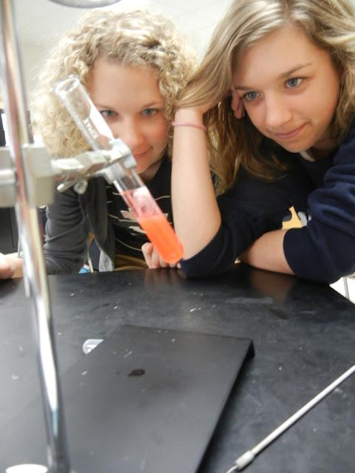
CHAPTER 13
Genetic Engineering

Slide 2
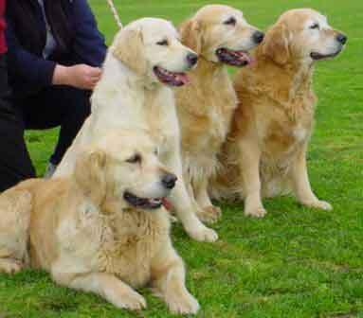
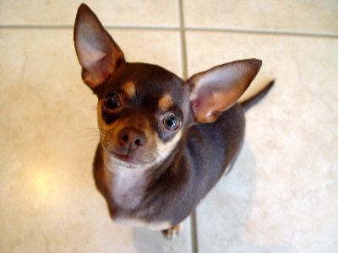
13-1 Changing the Living World
Selective Breeding
Choosing the “best” traits for breeding
Most domestic animals are products of SB

Slide 3
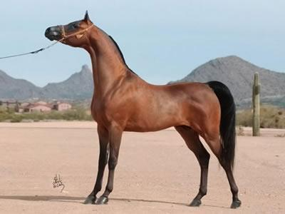
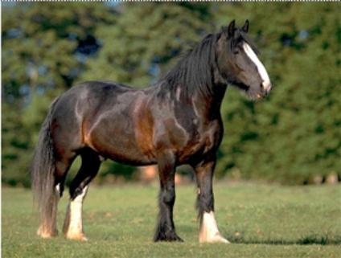
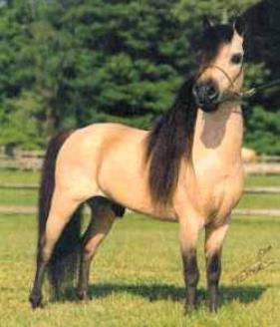
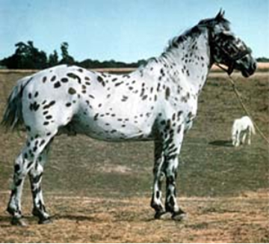
HORSES

Slide 4
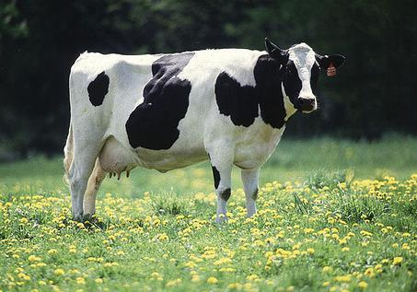
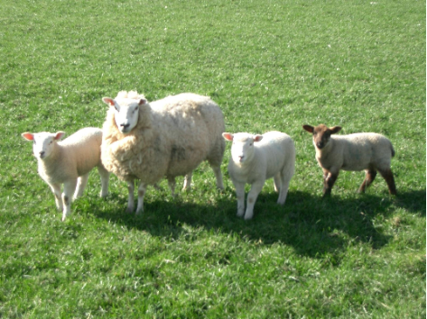
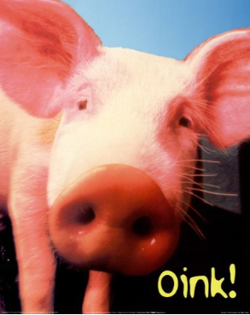
Even Cows, Sheep, & Pigs
All Products of Selective Breeding (Artificial Selection)

Slide 5
Hybridization
Crossing dissimilar individuals to bring together the best traits of both organisms
Produces hybrids
* Hybrids can be different species crossed together or different types within the same species.

Slide 6
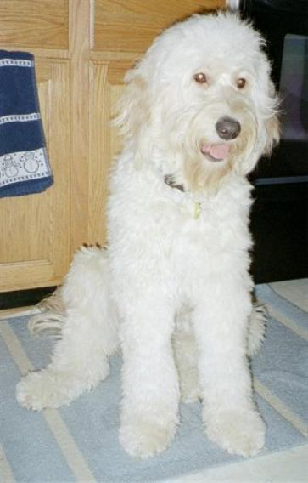
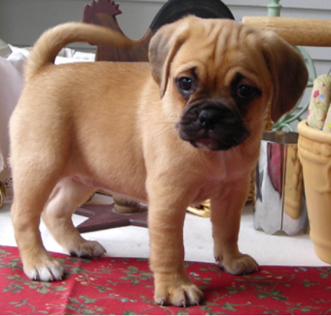
Golden Doodle Puggle
Designer breeds or mutts?

Slide 7
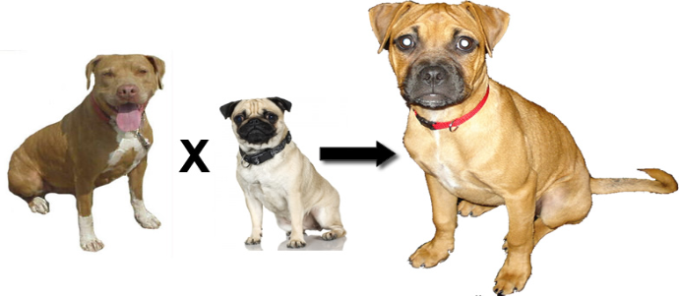
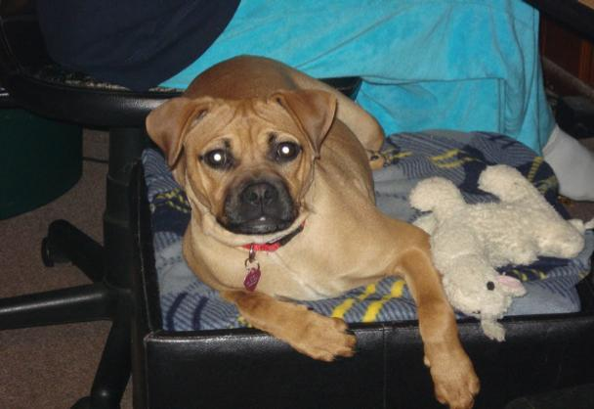

Slide 8
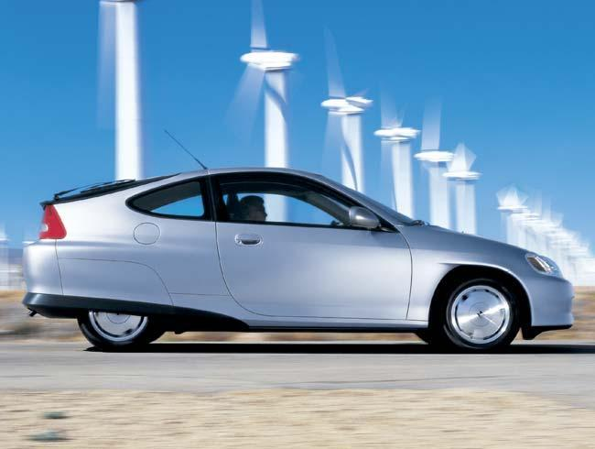
Not to be confused with hybrid cars..

Slide 9
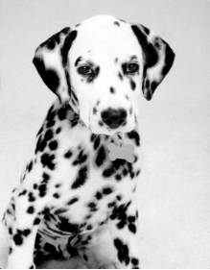
INBREEDING
Inbreeding = continued breeding of similar individuals (ex. pure breed dogs)
Has risks… increases breed’s susceptibility to disease & deformities
Golden retrievers - epilepsy
Dalmations - hereditary deafness

Slide 10
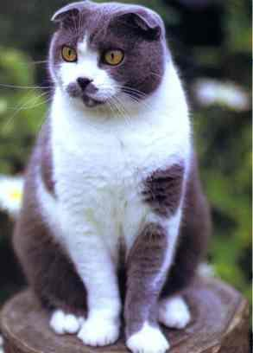
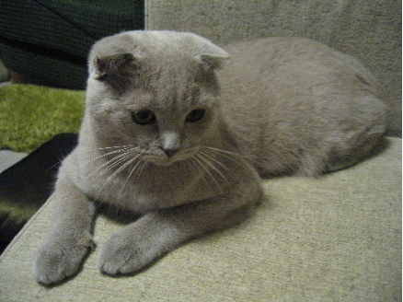
Mutation = any change in DNA ; can increase variation
Mutations can happen randomly, as in this Scottish fold cat. Cat enthusiasts bred these cats from a single cat with a mutation for the ears.

Slide 11
1. Dogs and other domestic animals were produced through many years of _______ breeding.
2. Two dissimilar organisms crossed together is called ___________________
3. Purebred dogs can sometimes have poor health due to __________
4. Any change in DNA is a ________
5. Designer dogs, such as the puggle are also called _______________

Slide 12
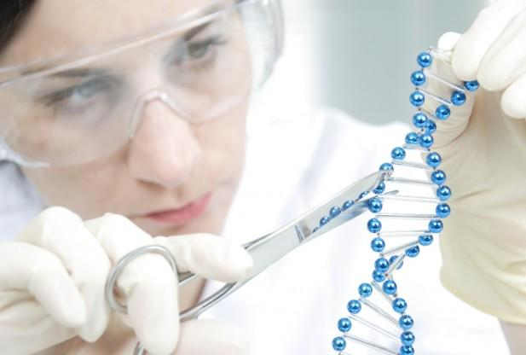
13-2 Manipulating DNA
GENETIC ENGINEERING
science of changing or modifying the DNA of an organism

Slide 13
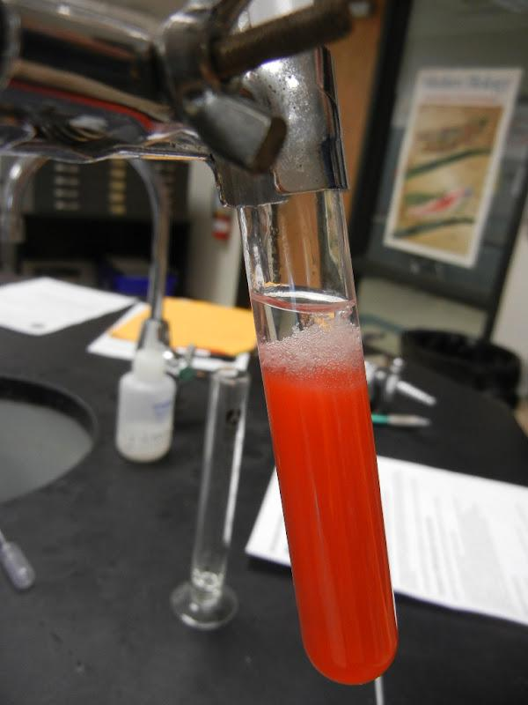
DNA extraction – process where DNA is removed from cells

Slide 14
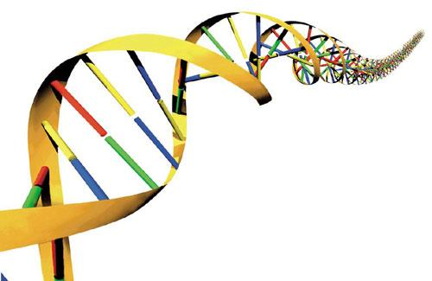
DNA SEQUENCE
- can be used to solve crimes, determine paternity, or test for genetic disorders
- Basically, the A’s T’s G’s and C’s are read

Slide 15
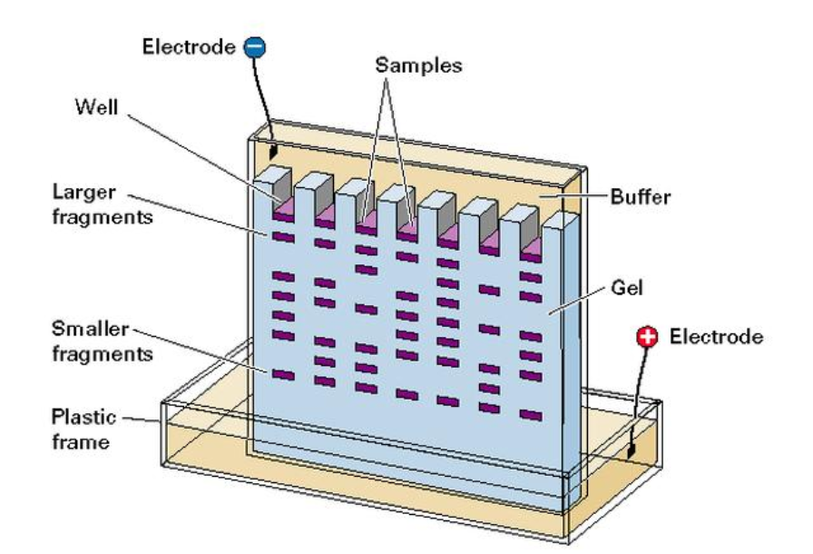
In gel electrophoresis, fragments of DNA are separated according to size.

Slide 16
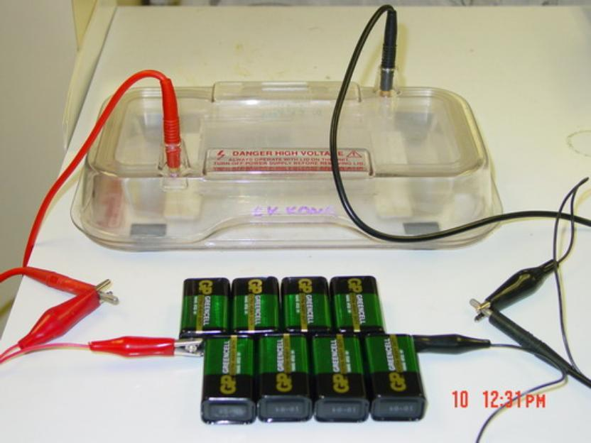

Slide 17
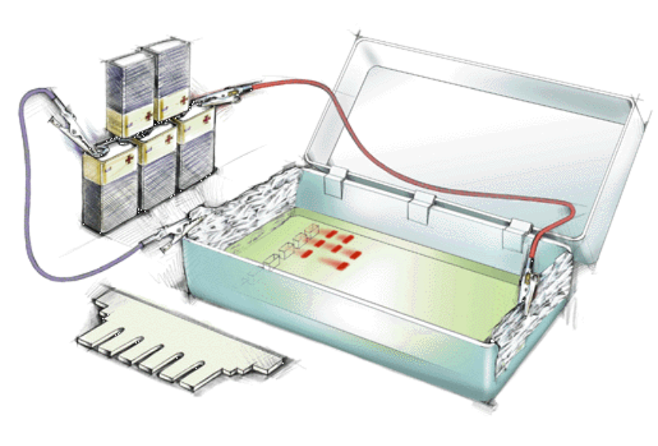

Slide 18
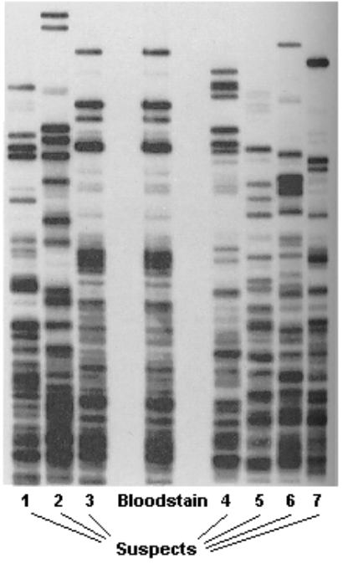
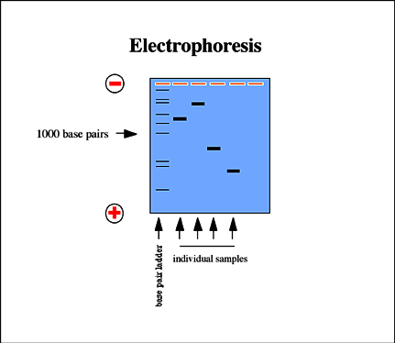
This image shows a DNA fingerprint where DNA from a bloodstain at a crime scene is compared to suspect DNA.

Slide 19
1. Making changes to DNA is called _________________ _______________
2. Gel __________________________ is used to separate DNA fragments
3. Scientists can _________ DNA from any cell or body tissue.
4. A DNA _____________ can be read to determine paternity or solve crimes

Slide 20
Transgenic Organisms
- Contain genes from other species
Microorganisms (bacteria)
Animals (mouse; medical uses)
Plants (agricultural uses)
GMO = genetically modified organism
This cartoon explains how genetic engineering was used to save the papaya.

Slide 21
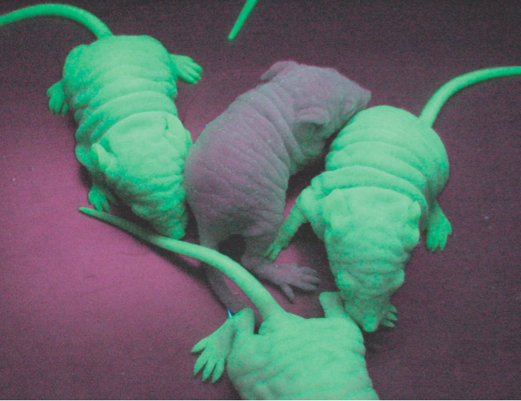
Gene causes these mice to glow in the dark. Normally, the gene is found in jellyfish.

Slide 22
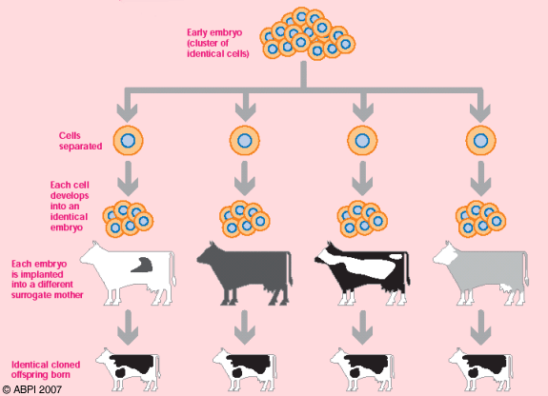
Cloning
1. Organisms with the same genetic code
2. Twins are natural clones
3. Clones can be created in the lab
The first clones were made with this process:
ARTIFICIAL TWINNING

Slide 23
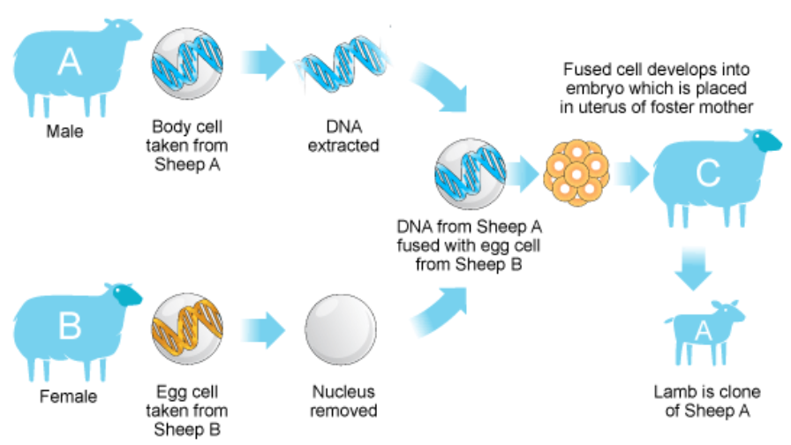
How to Clone a Sheep

Slide 24
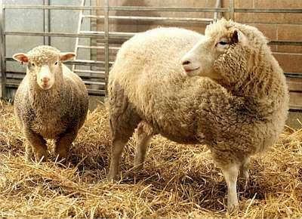
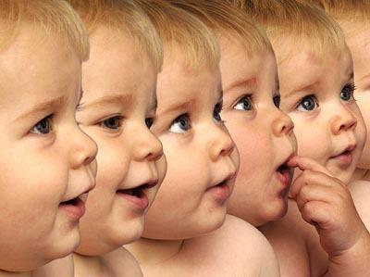
We have the technology to clone humans, but should we?
Can you think of any good reasons for cloning a human?

Slide 25
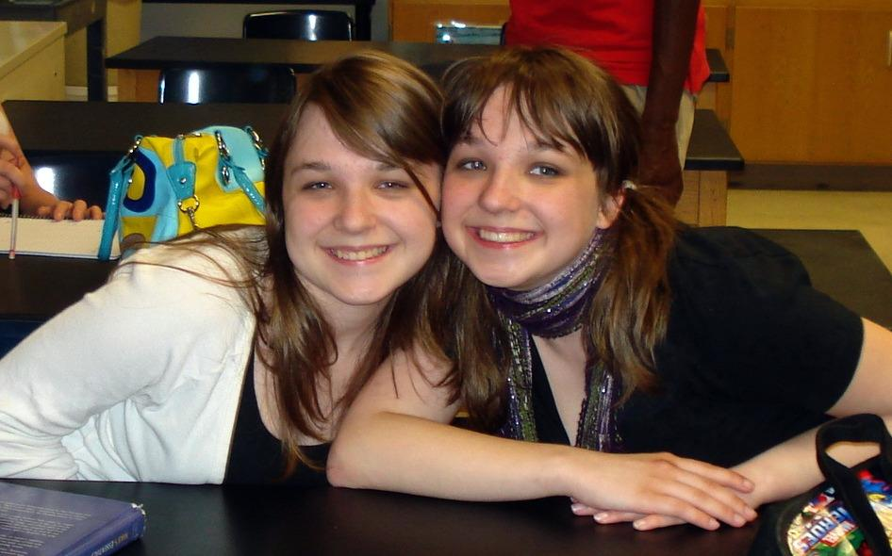
Clones do exist naturally. These are identical twins.

Slide 26
Click and Clone
http://learn.genetics.utah.edu/content/tech/cloning/clickandclone/

Slide 27
1. An animal that contains the genes of another species, like the glow-in-the-dark mice, is called a __________
organism.
2. A _______ is a genetically identical organism.
3. In humans, a naturally occurring clone is a ________
4. The first mammal that was cloned from a skin cell was a _______

Slide 28
5. With regard to cloning...it is necessary to have which of the following? Check all that apply...
___Cell from the adult to be cloned
___Egg with nucleus intact
___Embryo
___Surrogate mother
___ Sperm
___ Stem cells
___ Egg with nucleus removed

Slide 29
BIOETHICS
1. I would use genetic engineering to remove a harmful gene from my unborn child, such as the gene that causes cystic fibrosis.
2. I would use genetic engineering to remove an abnormal (but not necessarily harmful) gene from my unborn child; such as the gene that causes dwarfism.

Slide 30
3. I would use genetic engineering to remove a gene that is not desirable, such as the gene that causes baldness.
4. I would use genetic engineering to change a gene in my unborn child, such as their hair color or eye color.
5. I would use genetic engineering to add a gene to my child that is not human – such as a gene from another organism that could improve sight or running ability.

