Slide 1
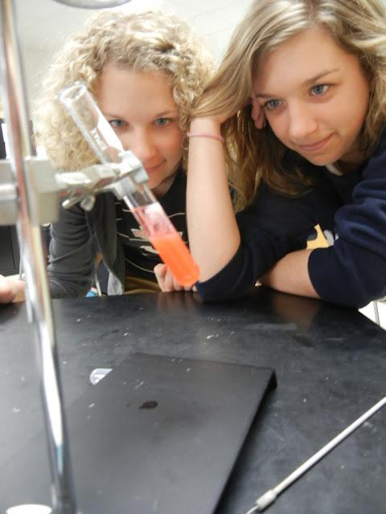
Biotechnology and
Genetic Engineering
The Supercow (A PRIME Example ;)

Slide 2
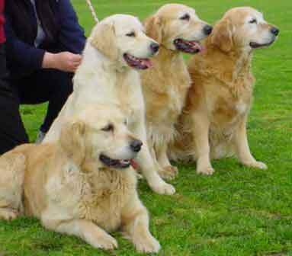
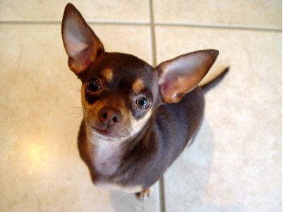
Means of Genetic Engineering
Selective Breeding
Choosing the “best” traits for breeding
Most domestic animals are products of SB

Slide 3
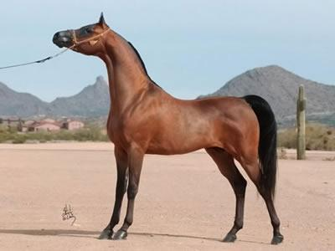
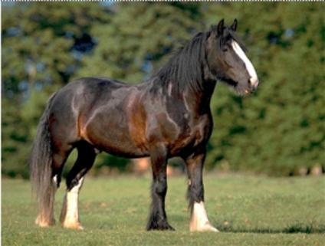
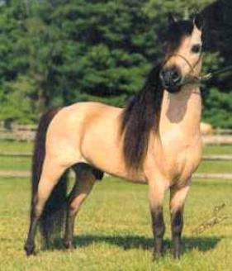
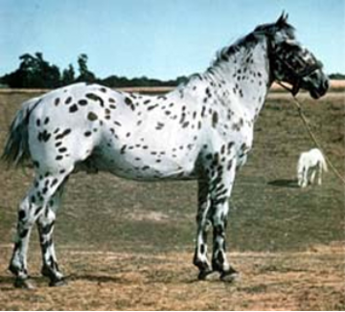
HORSES

Slide 4
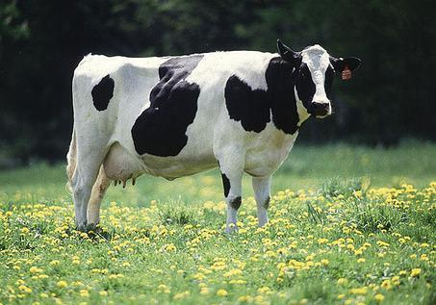
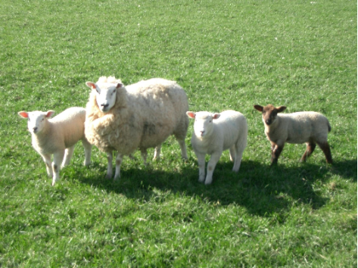
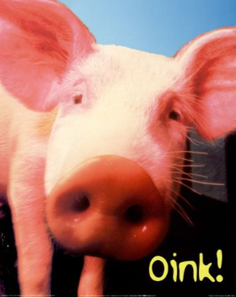
Even Cows, Sheep, & Pigs
All Products of Selective Breeding (Artificial Selection)

Slide 5
Hybridization
Crossing dissimilar individuals to bring together the best traits of both organisms
Produces hybrids
* Hybrids can be different species crossed together or different types within the same species.

Slide 6
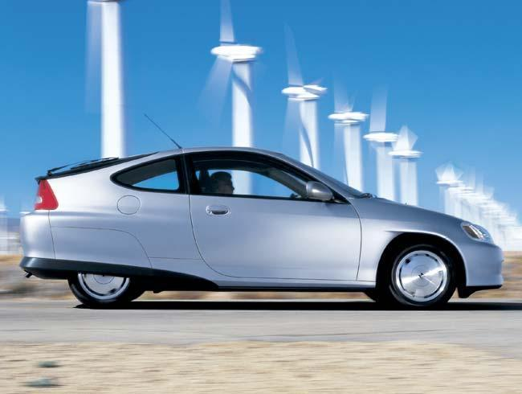
Not to be confused with hybrid cars..

Slide 7
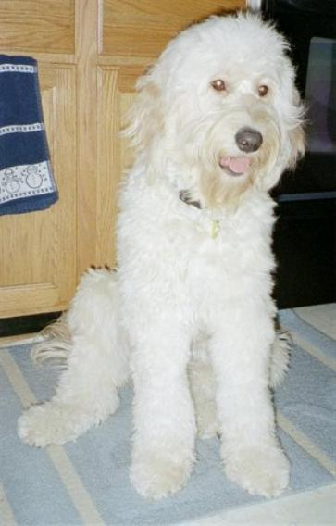
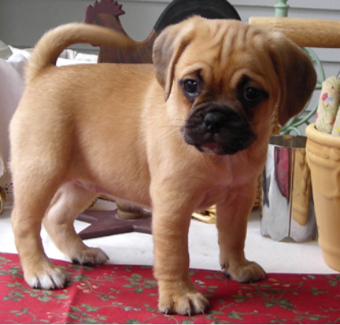
Golden Doodle Puggle
Designer breeds or mutts?

Slide 8
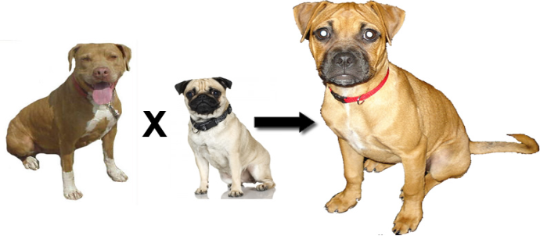
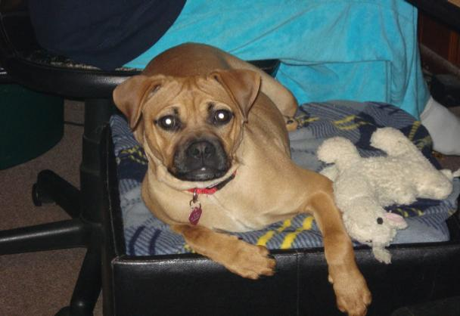

Slide 9
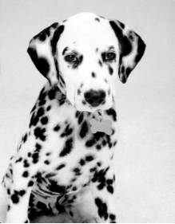
INBREEDING
Inbreeding = continued breeding of similar individuals (ex. pure breed dogs)
Has risks… increases breed’s susceptibility to disease & deformities
Golden retrievers - epilepsy
Dalmations - hereditary deafness

Slide 10
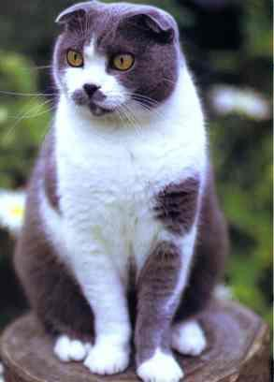
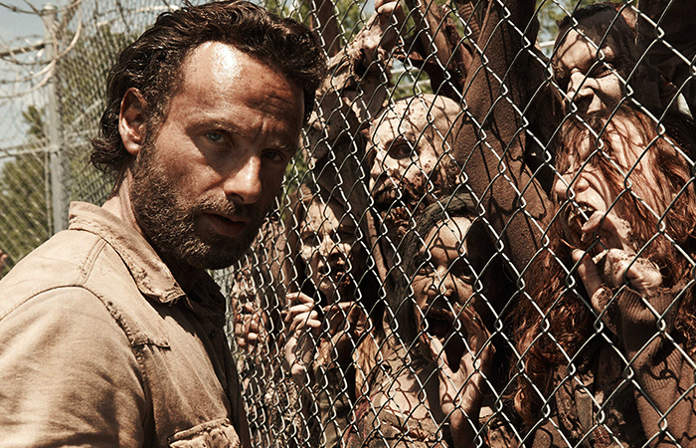
Mutation = any change in DNA;
increases variation
REMEMBER KIDS, VARIATION IS GOOD BECAUSE IT ENSURES WE WON’T ALL BE KILLED OFF IN A ZOMBIE APOCALYPSE.
Mutations can happen randomly, as in this Scottish fold cat. Cat enthusiasts bred these cats from a single cat with a mutation for the ears.

Slide 11
1. Dogs and other domestic animals were produced through many years of _______ breeding.
2. Two dissimilar organisms crossed together is called ___________________
3. Purebred dogs can sometimes have poor health due to __________
4. Any change in DNA is a ________
5. Designer dogs, such as the puggle are also called _______________

Slide 12
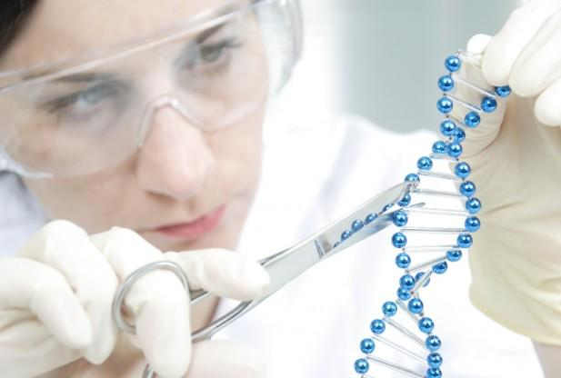
Manipulating DNA
GENETIC ENGINEERING
science of changing or modifying the DNA of an organism
HOW TO MAKE DINOSAURS

Slide 13
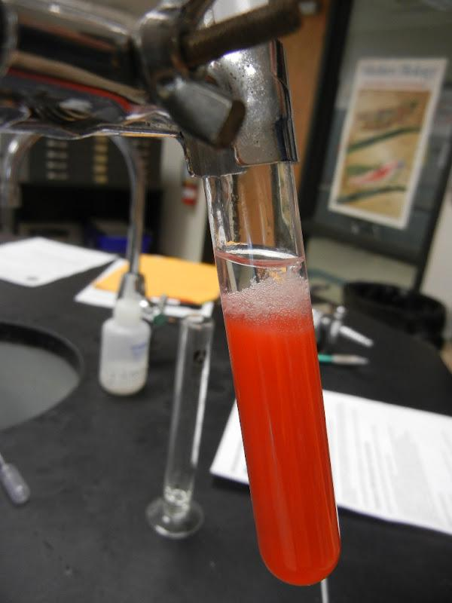
DNA extraction – process where DNA is removed from cells

Slide 14
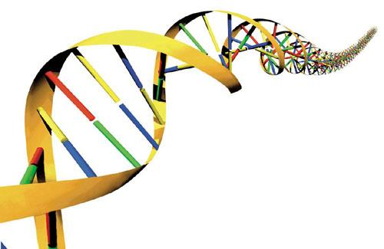
DNA SEQUENCE
- can be used to solve crimes, determine paternity, or test for genetic disorders
- Basically, the A’s T’s G’s and C’s are read

Slide 15
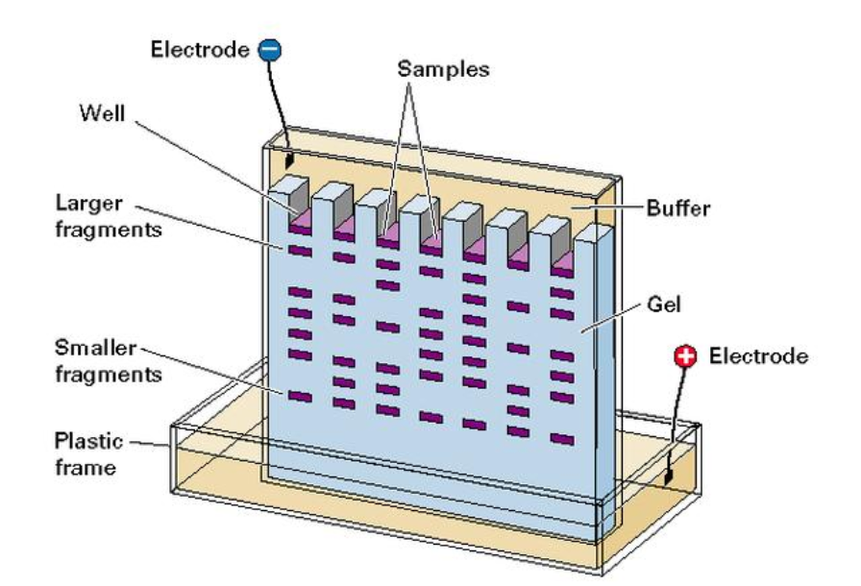
In gel electrophoresis, fragments of DNA are separated according to size.

Slide 16
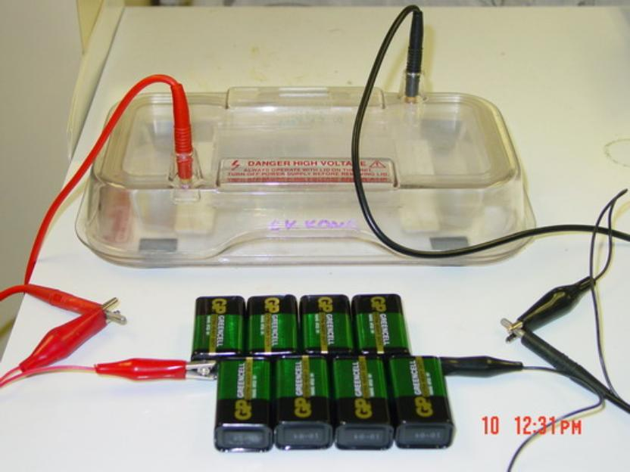

Slide 17
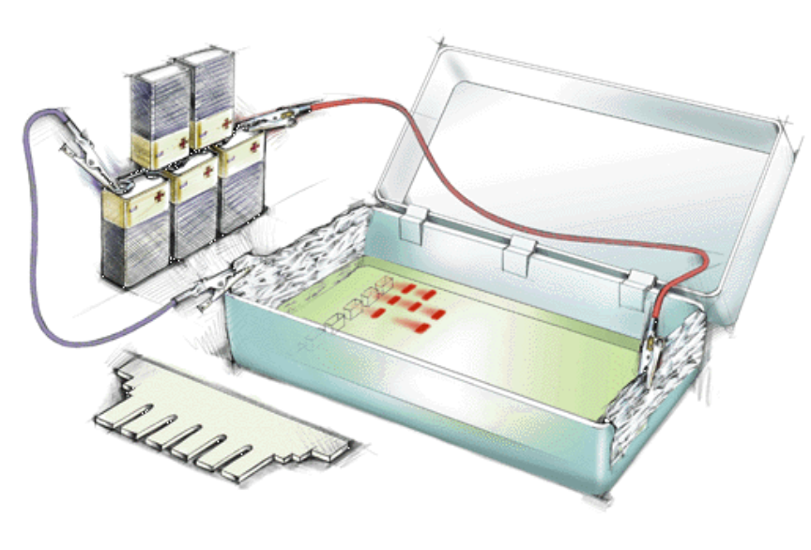

Slide 18
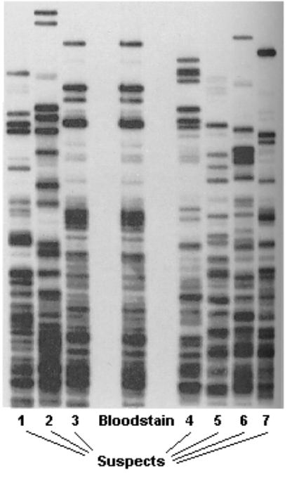
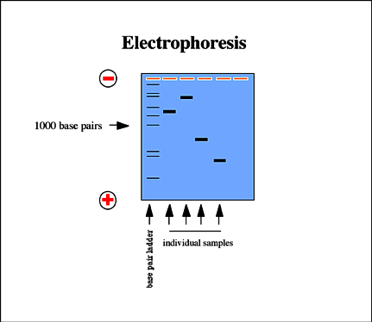
This image shows a DNA fingerprint where DNA from a bloodstain at a crime scene is compared to suspect DNA.

Slide 19
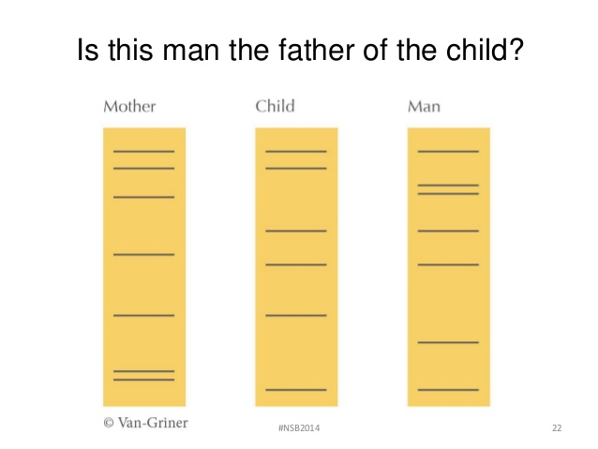
Scientists must trace each section of DNA back to the parent(s) in question to determine paternity/maternity

Slide 20
1. Making changes to DNA is called _________________ _______________
2. Gel __________________________ is used to separate DNA fragments
3. Scientists can _________ DNA from any cell or body tissue.
4. A DNA _____________ can be read to determine paternity or solve crimes

Slide 21
Transgenic Organisms
- Contain genes from other species
Microorganisms (bacteria)
Animals (mouse; medical uses)
Plants (agricultural uses)
GMO = genetically modified organism
Do you eat GMO’s?

Slide 22
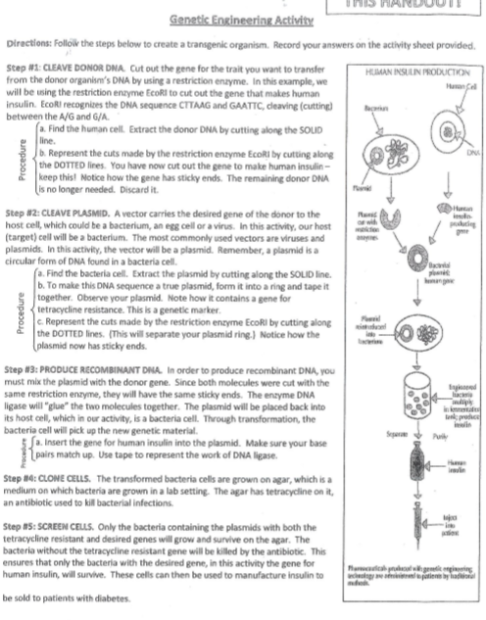

Slide 23
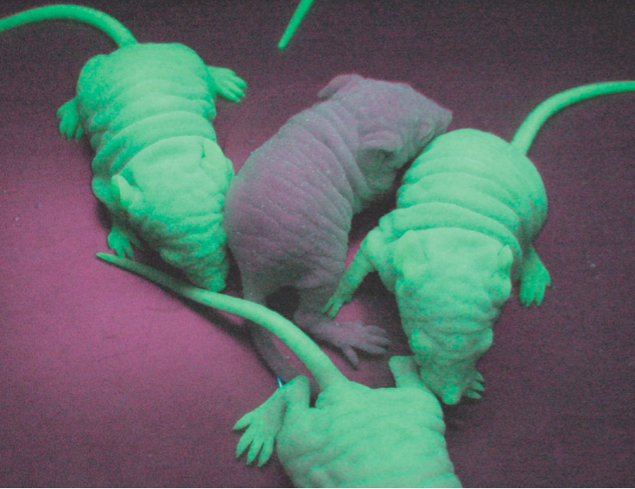
Gene causes these mice to glow in the dark. Normally, the gene is found in jellyfish.

Slide 24
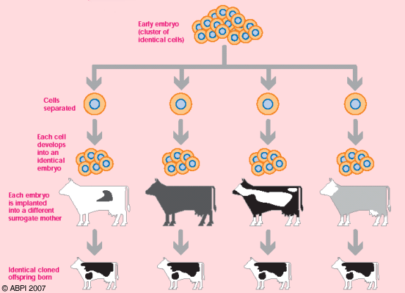
Cloning
1. Organisms with the same genetic code
2. Twins are natural clones
3. Clones can be created in the lab
The first clones were made with this process:
ARTIFICIAL TWINNING

Slide 25
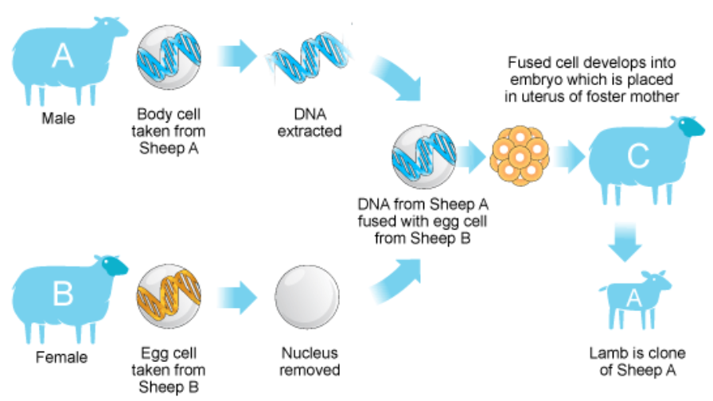
How to Clone a Sheep

Slide 26
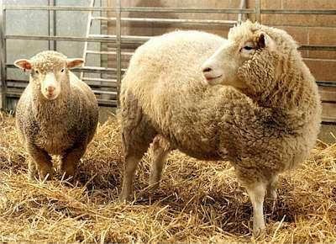
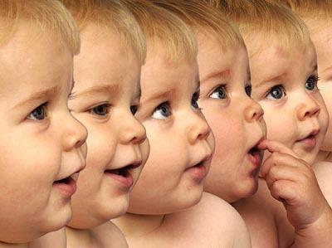
We have the technology to clone humans, but should we?
Can you think of any good reasons for cloning a human?

Slide 27
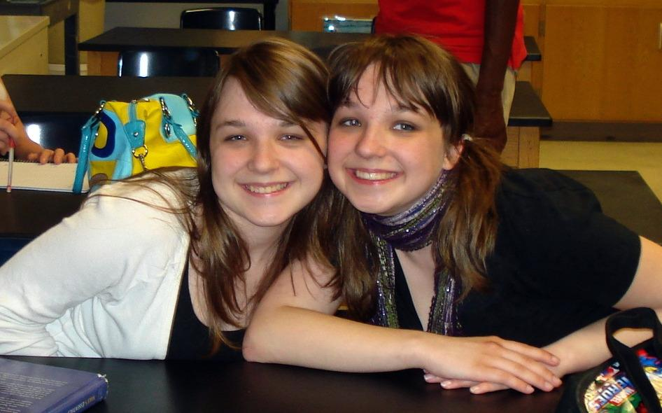
Clones do exist naturally. These are identical twins.

Slide 28
Click and Clone
http://learn.genetics.utah.edu/content/tech/cloning/clickandclone/

Slide 29
1. An animal that contains the genes of another species, like the glow-in-the-dark mice, is called a __________
organism.
2. A _______ is a genetically identical organism.
3. In humans, a naturally occurring clone is a ________
4. The first mammal that was cloned from a skin cell was a _______

Slide 30
5. With regard to cloning...it is necessary to have which of the following? Check all that apply...
___Cell from the adult to be cloned
___Egg with nucleus intact
___Embryo
___Surrogate mother
___ Sperm
___ Stem cells
___ Egg with nucleus removed

Slide 31
BIOETHICS
1. I would use genetic engineering to remove a harmful gene from my unborn child, such as the gene that causes cystic fibrosis.
2. I would use genetic engineering to remove an abnormal (but not necessarily harmful) gene from my unborn child; such as the gene that causes dwarfism.

Slide 32
3. I would use genetic engineering to remove a gene that is not desirable, such as the gene that causes baldness.
4. I would use genetic engineering to change a gene in my unborn child, such as their hair color or eye color.
5. I would use genetic engineering to add a gene to my child that is not human – such as a gene from another organism that could improve sight or running ability.

Slide 33
Human Genome Project
The Human Genome Project (HGP) was the international, collaborative research program whose goal was the complete mapping and understanding of all the genes of human beings. All our genes together are known as our "genome.“ It took place from 1990-2003.
Watch this

