Slide 1
Characteristics of Life

Slide 2
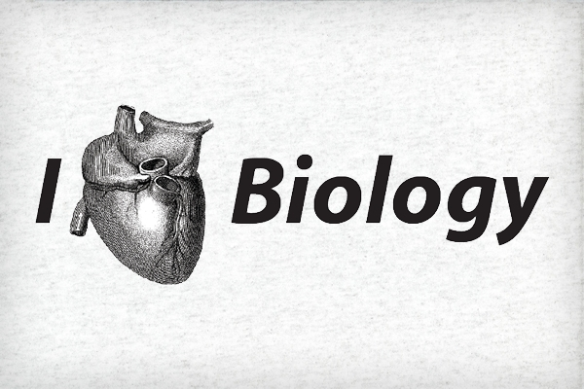
Biology!!
The study of ????

Slide 3
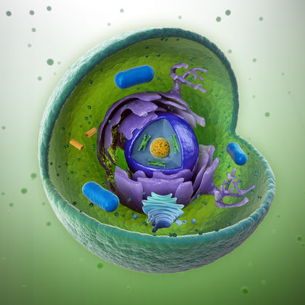
Characteristics of Living Things:
Cellular basis of life
All living things are made of __________?

Slide 4
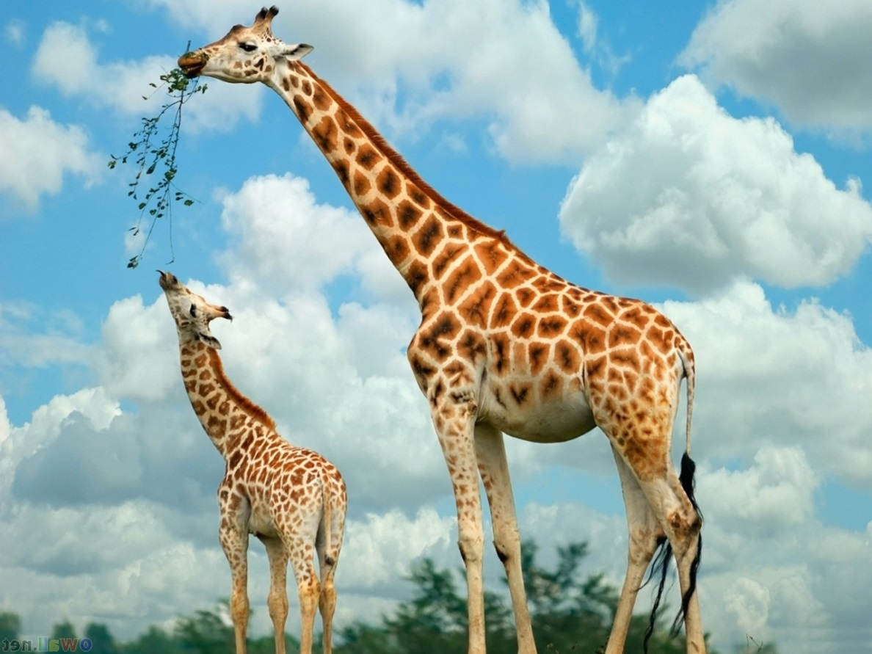
Characteristics of Living Things:
Reproduction
Why??

Slide 5
Characteristics of Living Things:
Based on a genetic code
_____ gets passed on from generation to generation

Slide 6
Characteristics of Living Things:
Grow and develop

Slide 7
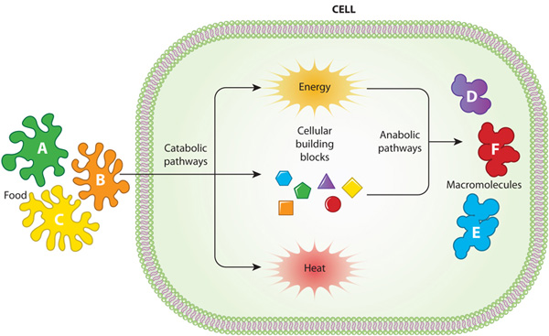
Characteristics of Living Things:
Metabolism
Involves the use of ________

Slide 8
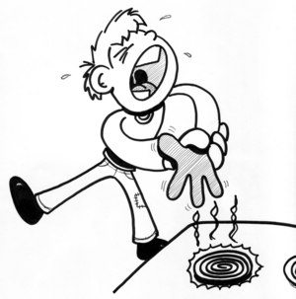
Characteristics of Living Things:
Respond to the environment

Slide 9
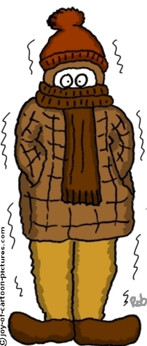
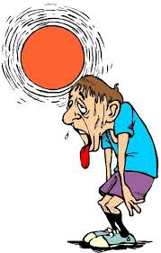
Characteristics of Living Things:
Homeostasis
Maintain a stable internal balance

Slide 10
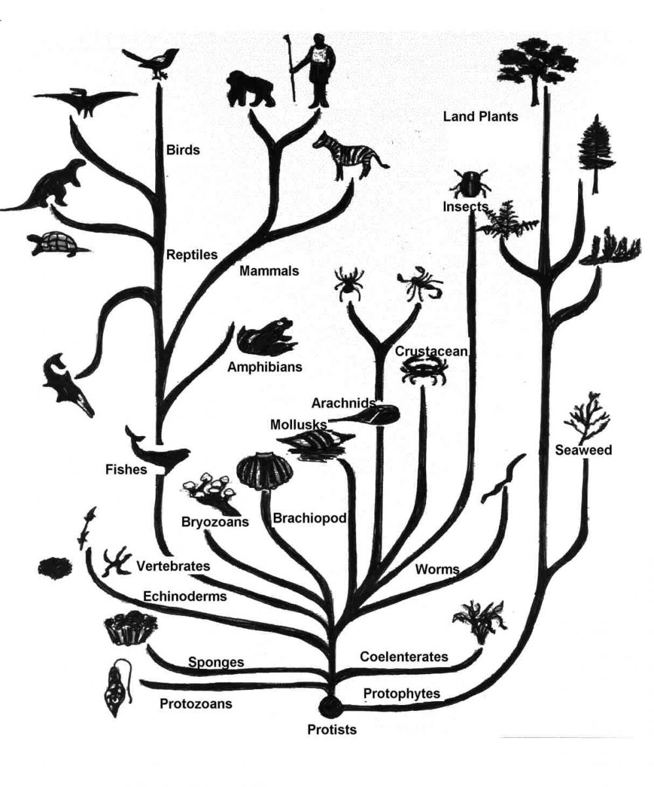
Characteristics of Living Things:
Adapt/evolve
Change in a population/species over time

