Slide 1
DNA, RNA, & Protein Synthesis

Slide 2
DNA Replication
DNA is unzipped by a helicase enzyme, which breaks the hydrogen bonds.
Complementary bases (A &T, C&G) are paired by DNA polymerase enzymes.
Two new strands of identical DNA are made
This process is semi-conservative because each half of the new strand is made of an old strand.

Slide 3
DNA Replication

Slide 4
Protein Synthesis

Slide 5
Central dogma of genetics
DNA mRNA Protein
(Transcription) (Translation)
DNA codes for mRNA
mRNA codes for proteins

Slide 6
Protein synthesis
Proteins are the basis for all our traits.
DNA controls the synthesis (making) of proteins
DNA is only found in the nucleus
Proteins are made in the ribosomes
Ribosomes are located in the cytoplasm and rough ER

Slide 7
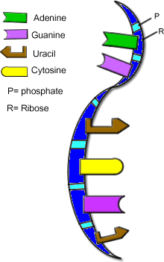
RNA – ribonucleic acid
RNA contains the sugar ribose.
DNA contains sugar deoxyribose.
RNA is a single stranded molecule.
DNA is a double stranded molecule.
RNA nitrogen bases are Adenine,
Guanine, Cytosine and Uracil
( G – C ; A – U )
DNA bases are Adenine, Guanine, Cytosine and Thymine ( A – T ; G – C )

Slide 8
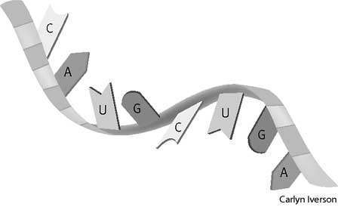
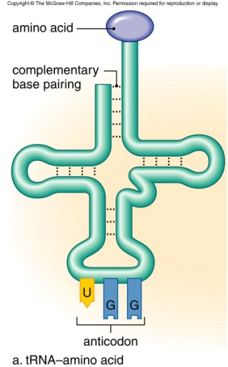
RNA types
3 types of RNA:
mRNA – messenger RNA
Single stranded, linear
Carries the instructions from
the nucleus to the ribosome
tRNA – transfer RNA
Clover-leaf shape
Carries amino acids to the
ribosome for assembly
into proteins
rRNA – ribosomal RNA
Is what ribosomes are made of

Slide 9
Transcription
DNA template strand is read to make mRNA
The enzyme RNA polymerase unzips DNA
mRNA nucleotides bond with the template strand of DNA until it reaches a stop codon
mRNA leaves the nucleus and travels to the ribosome

Slide 10
Translation
mRNA is read to make proteins
mRNA attaches to the ribosome
Ribosome begins reading codons
Codon = group of 3 bases that codes for an amino acid
tRNA brings the correct amino acid to the ribosome
Ribosome assembles protein (polypeptide) by combining amino acids using peptide bonds

Slide 11
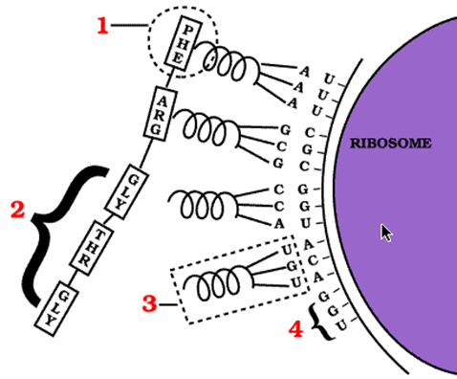

Slide 12
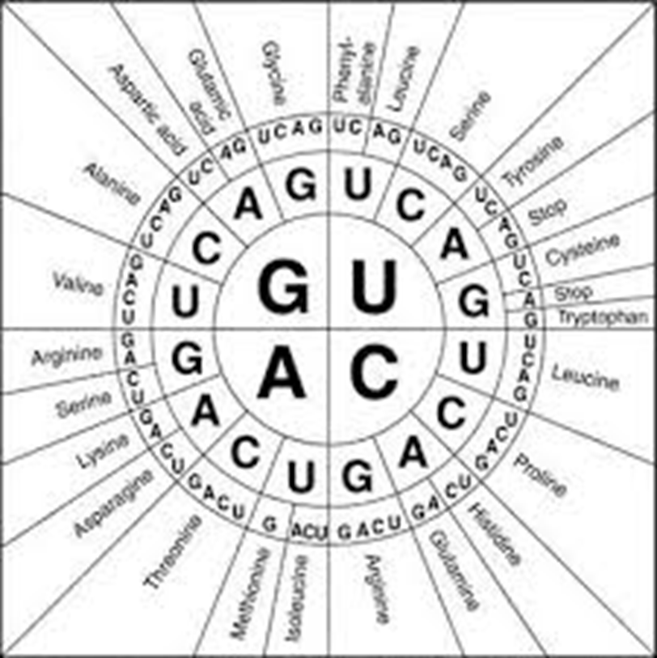
Codon chart

Slide 13
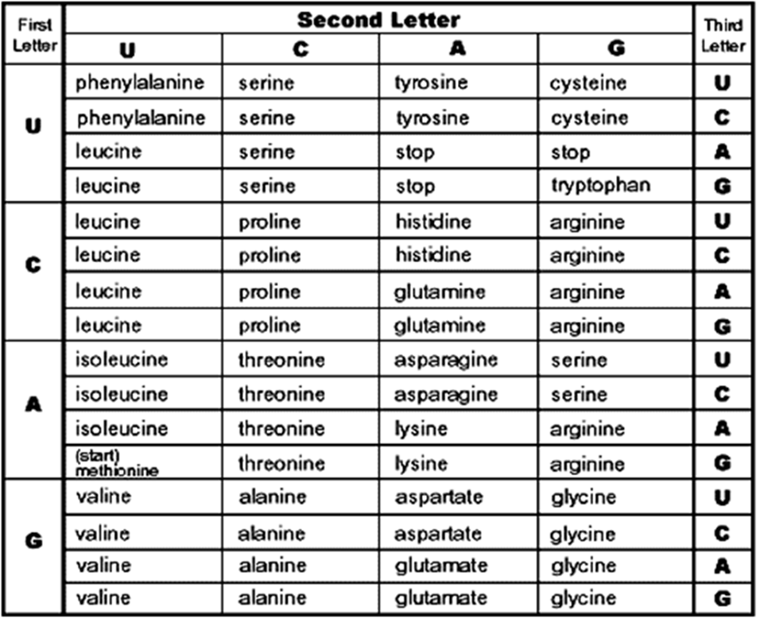
Codon chart

Slide 14
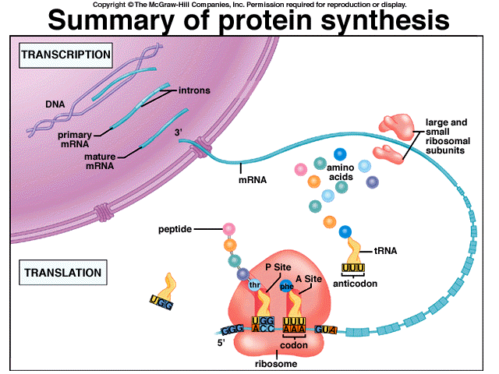

Slide 15
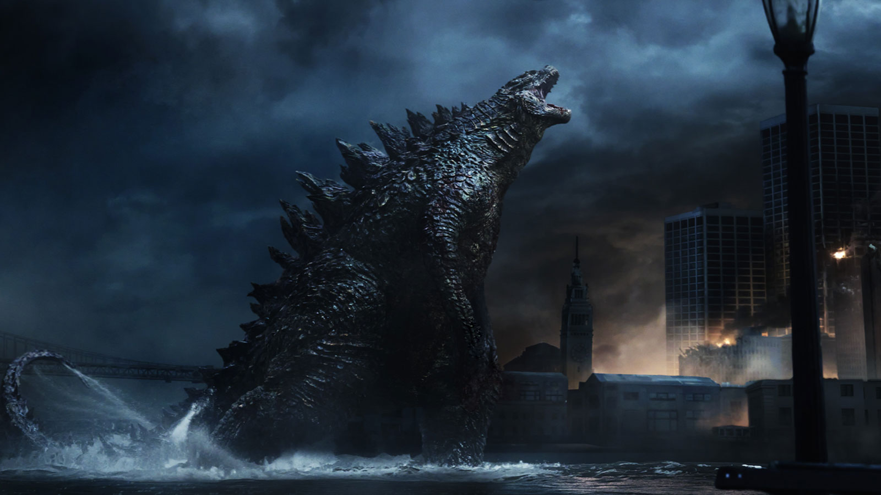
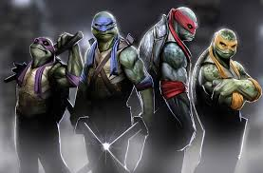
Mutations in pop culture

Slide 16
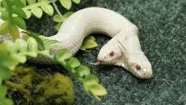
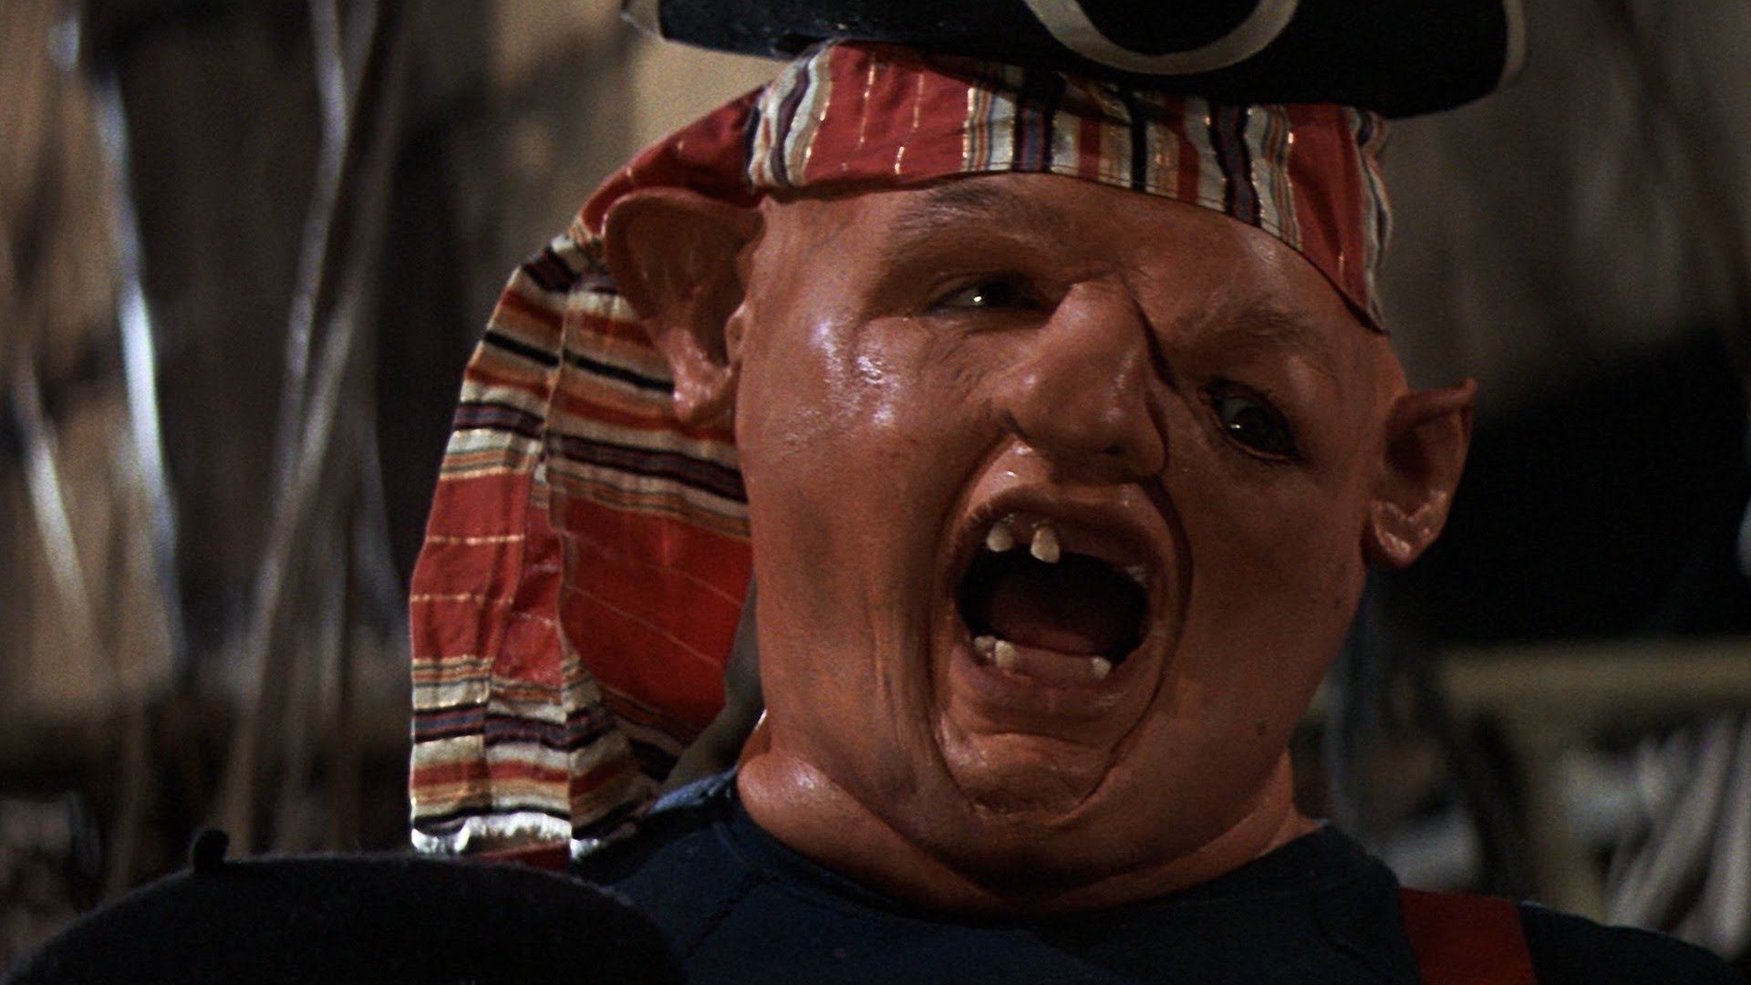
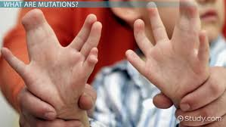
Mutations in real life *most mutations are neutral

Slide 17
Gene Mutations
Change in the nucleotide sequence of a gene
May only involve a single nucleotide
May be due to copying errors, chemicals, viruses, etc.

Slide 18
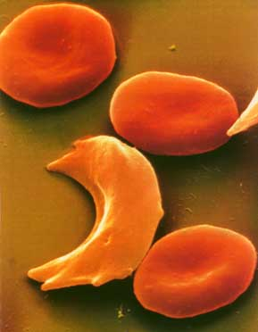
Point Mutation
Sickle Cell disease is the result of one nucleotide substitution
Occurs in the hemoglobin gene

Slide 19
Frameshift Mutation
Inserting or deleting one or more nucleotides
Changes the “reading frame” like changing a sentence
Proteins built incorrectly

Slide 20
Frameshift Mutation
Original:
The fat cat ate the wee rat.
Frame Shift (“a” added):
The fat caa tet hew eer at.

Slide 21
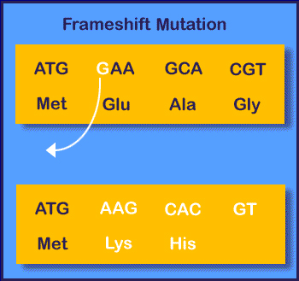
Amino Acid Sequence Changed

