Slide 1
Population Growth

Slide 2
Characteristics of Populations
Geographic distribution
Density
Growth Rate

Slide 3
Factors that Affect Growth Rate
Number of births
Number of deaths
Number of individuals entering or leaving the population.
Immigration:
Emigration:

Slide 4
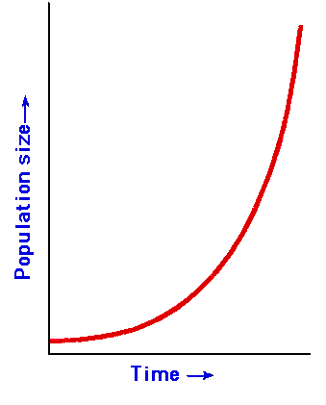
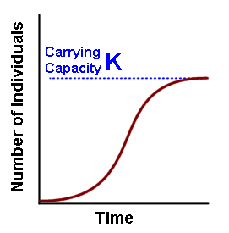
Types of Growth
Exponential Growth
Logistic Growth

Slide 5
Carrying Capacity
The maximum population size of the species that the environment can sustain indefinitely

Slide 6
Types of Limiting Factors
Density dependent factors depend on how close a population is together.
e.g. disease, parasitism
Density independent factors do not depend on how close a population is together because it affects a large area.
e.g. fire, drought, natural disasters

Slide 7
Invasive Species
A species not native to an area is exotic/invasive and usually grow rapidly.
e.g. pythons in the Everglades, kudzu in N.C., fire ants in the South
FISH THAT FLY?

Slide 8
Demography
Study of HUMAN populations
The human population has increased over time.
Exponential or Logistic growth??

Slide 9
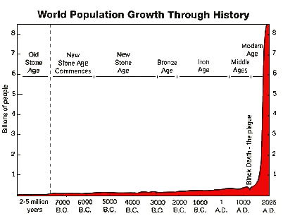
Human Population Growth
LIVE RESULTS!

Slide 10
Age Structure
Demographers create age structure diagrams which predict growth rates
These show different levels of growth in a population
What type of growth does USA have?

Slide 11
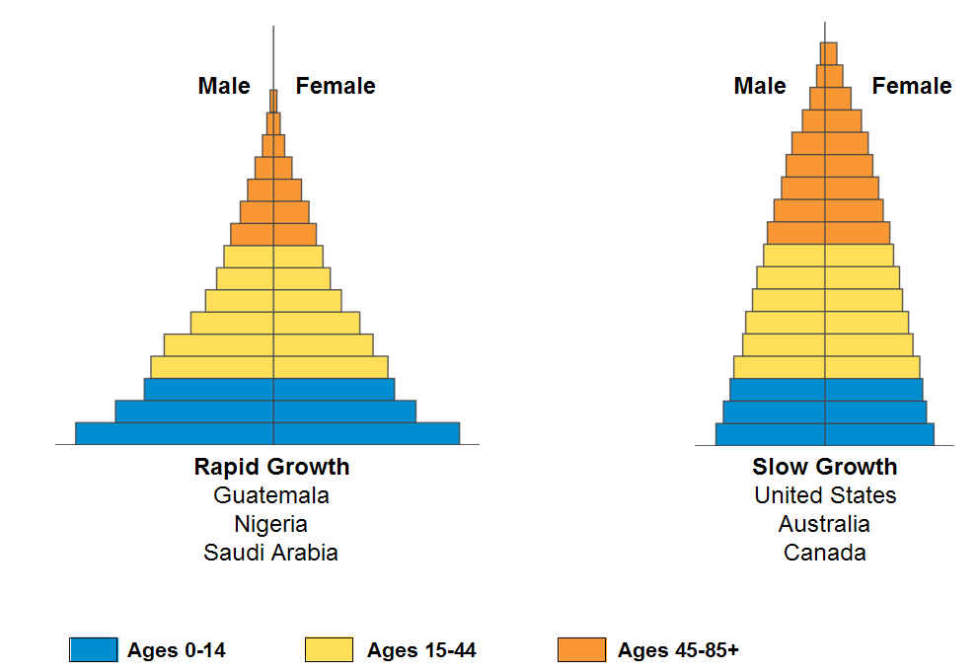
Age Structure Diagrams

Slide 12
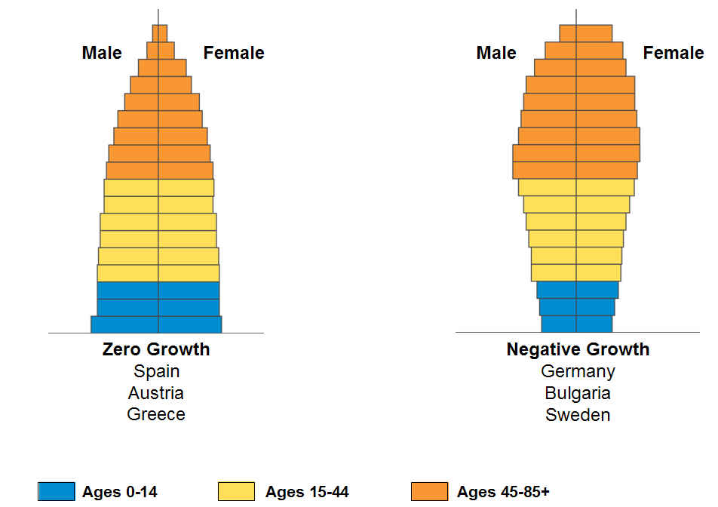
Age Structure Diagrams

Slide 13
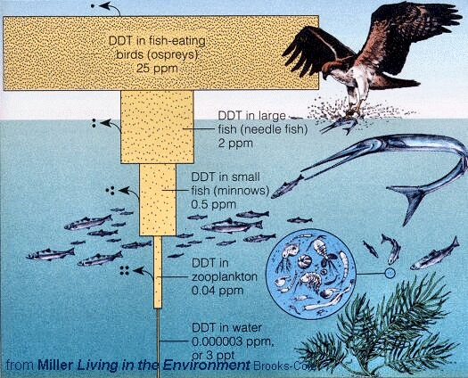
Bioaccumulation

Slide 14
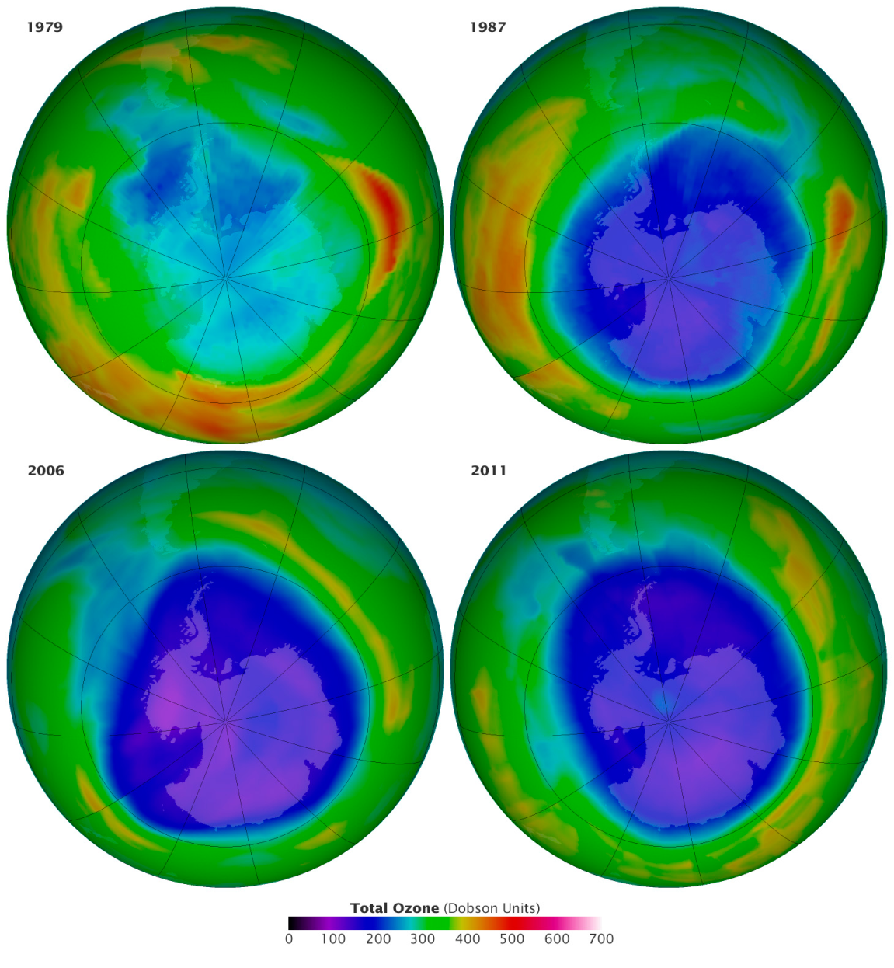
Global Warming Vs. Ozone Depletion
Rising temperatures caused by greenhouse effect (greenhouse gasses)
Vs
increased rate of skin cancer (etc.) due to CFC’s

Slide 15
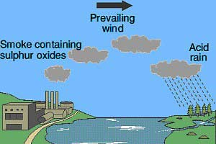
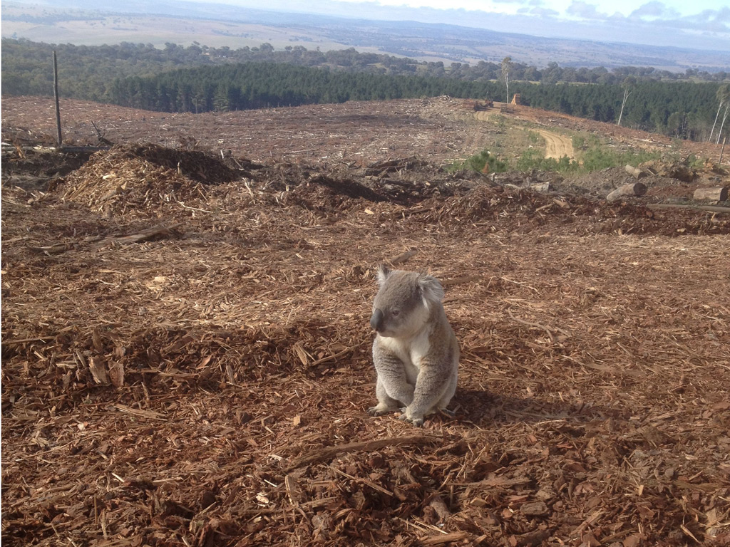
Acid Rain and Deforestation
Both kill plants and cause habitat degradation.

Slide 16
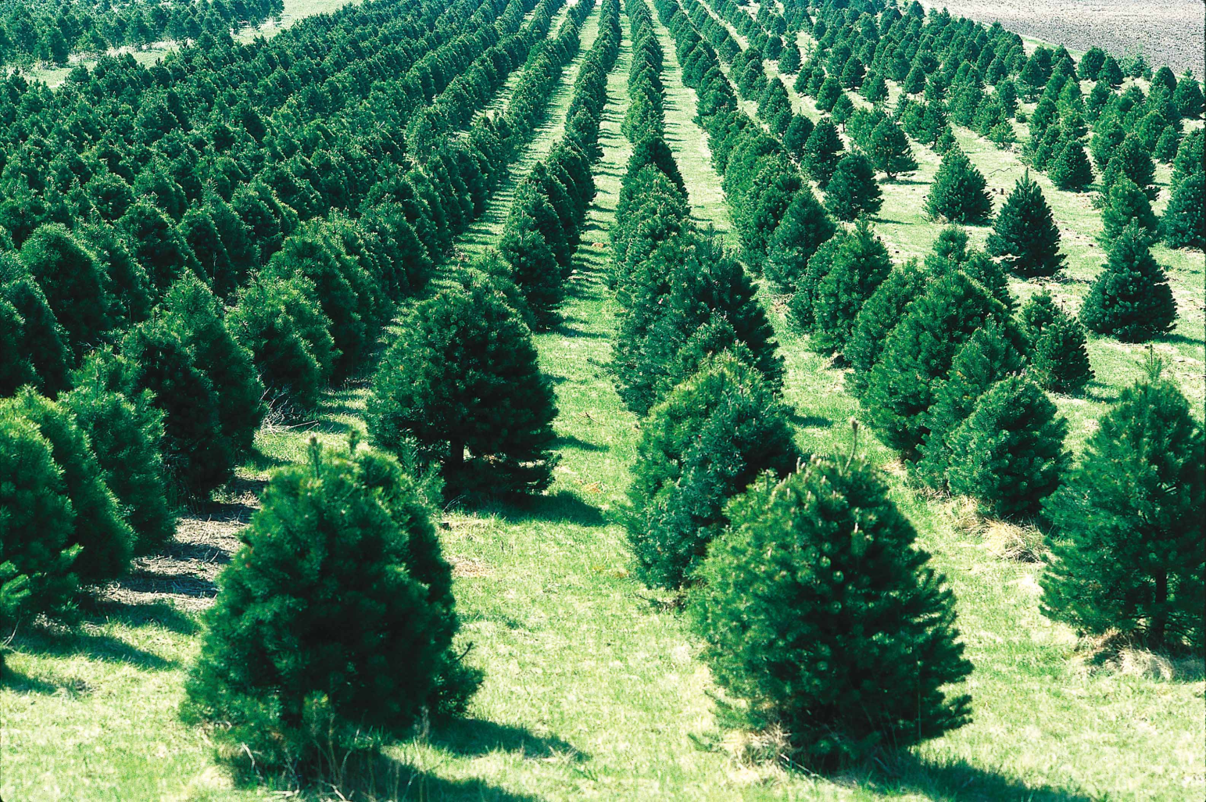
Sustainable Development
Reforestation is one way we can practice sustainable development.

Slide 17
Plant and Animal Behavioral Adaptations
A taxis is a response to the environment.
e.g. chemotaxis, phototaxis
A positive taxis means the organism likes the
stimulus. (e.g. dog moves toward food)
A negative taxis means the organism does not like the stimulus. (e.g. bug moves away from light)

Slide 18
Vaccines
Vaccines trigger the production of antibodies which fight off disease.

Slide 19
Animal Behavior
Classical conditioning – learning to associate a stimulus and response (e.g. Pavlov’s dogs)
Operant conditioning – learning via punishment and reward (e.g. Skinner box)

