Slide 1
Darwin’s Theory of Evolution
Evolution

Slide 2
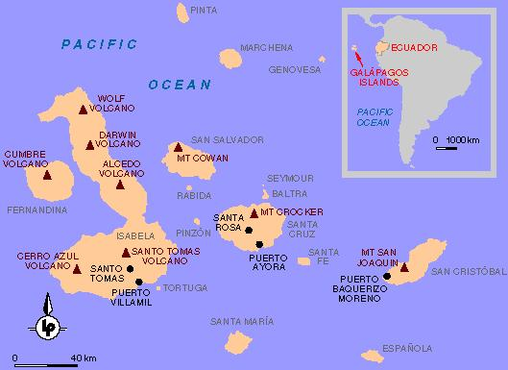
Charles Darwin (1809 – 1882)
Served on the H.M.S. Beagle that sailed on a 5 year expedition.
One of the locations visited was the Galapagos Islands, west of South America

Slide 3
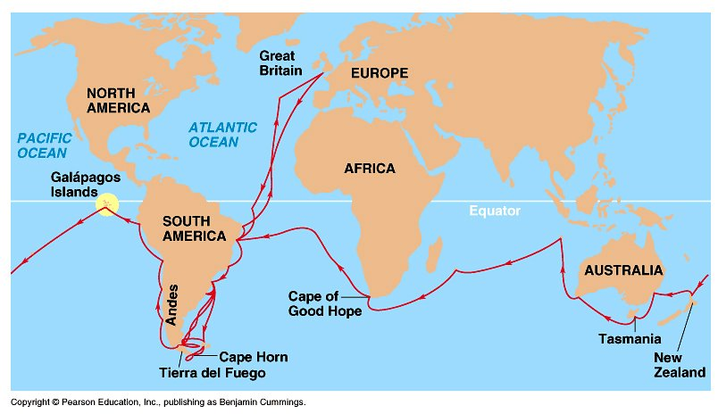
Darwin’s Travels

Slide 4
What Darwin Saw…
Collected many species of finches.
All the birds were similar, except for the shape of their beaks.
Hypothesized that a few birds must have migrated form the mainland and adapted to the different island environments.

Slide 5
Ideas that Shaped Darwin’s Thinking

Slide 6
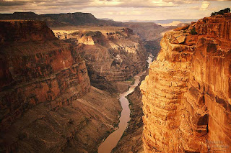
Hutton and Lyell
Came up with the idea of uniformitarianism.
Small changes over long time periods.
Canyons, mountains, etc.

Slide 7
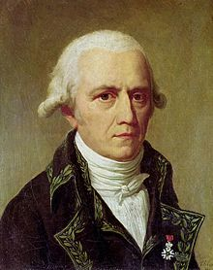
Jean Baptiste Lamark
One of the first scientists to recognize that living things have changed over time.
3 ideas behind his theory of evolution…

Slide 8
Jean Baptiste Lamark
All organisms are continually changing in order to reach perfection.

Slide 9
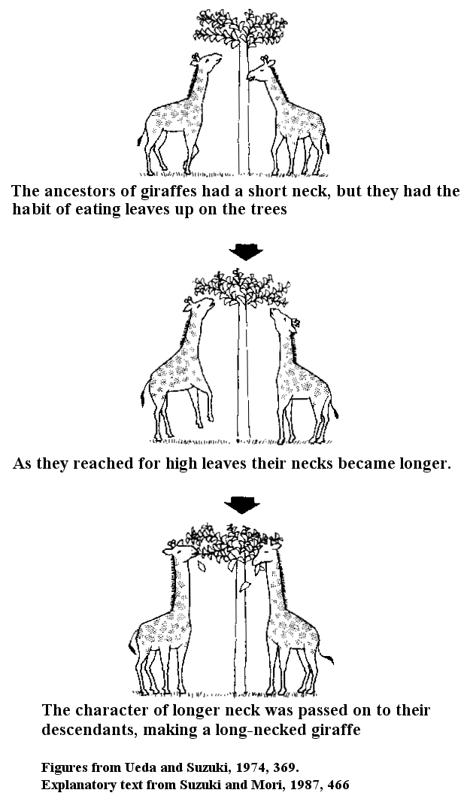
Jean Baptiste Lamark
Organisms can alter their bodies by the principle of use and disuse.
Acquired characteristics could be inherited.

Slide 10
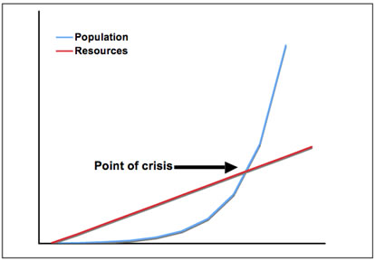
Thomas Malthus
Stated that if the human population continued to grow, sooner or later there would not be enough resources for everyone…
What did Darwin think about that?

Slide 11
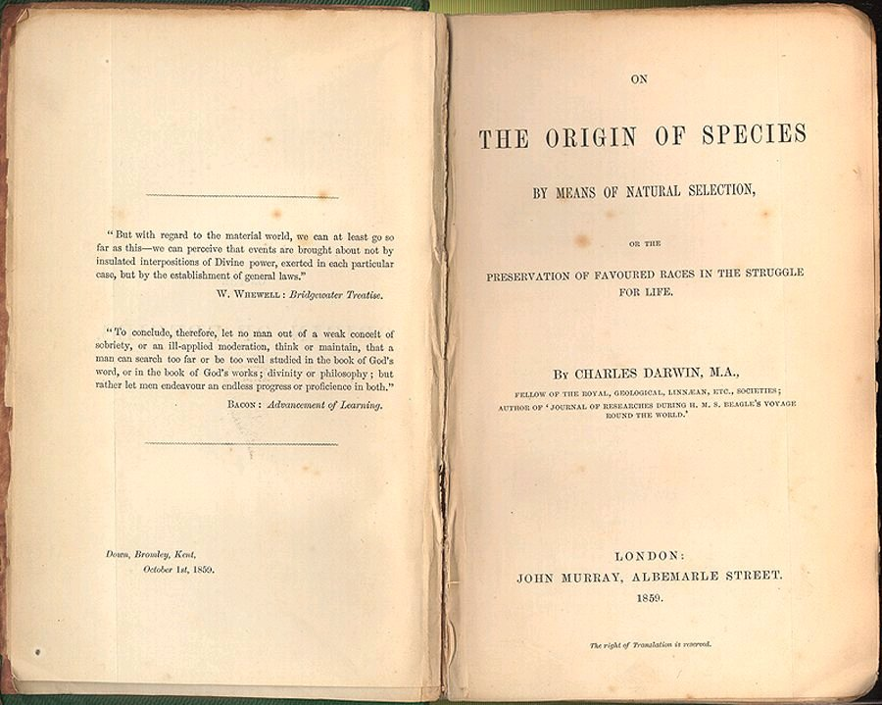
Darwin’s Explanation
Darwin was forced to publish his work when another scientist, Alfred Russell Wallace, came up with similar ideas.
“On the Origin of Species” stirred up controversy world wide!

Slide 12
What Darwin Proposed…
Natural Selection
Process by which organisms change over time.
3 ideas behind his theory of evolution…

Slide 13
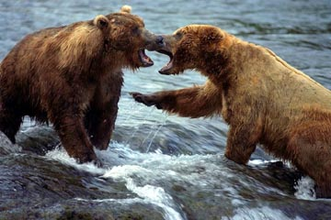
Darwin’s 3 Ideas
When organisms compete for resources there is a struggle for existence, meaning that some organisms die.

Slide 14
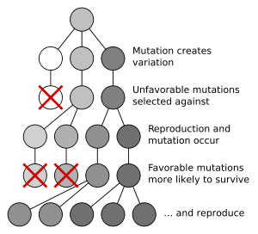
Darwin’s 3 Ideas
The ability of an individual to survive results in how well adapted it is to its environment.
Nature selects which individuals will live → “Natural Selection”

Slide 15
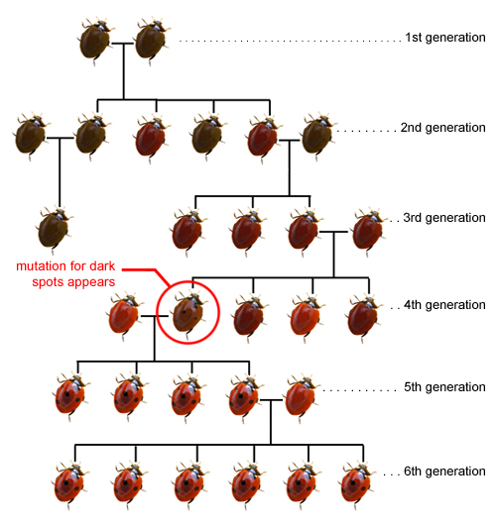
Darwin’s 3 Ideas
Over long periods of time, natural selection produces organisms that are different from their ancestors.
Called this Descent with Modification

