Slide 1
Early Earth History

Slide 2
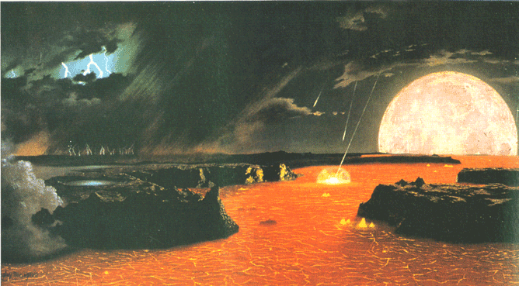
Formation of Earth
Geologic evidence shows that Earth is about 4.6 billion years old.
The early atmosphere was composed of water vapor, hydrogen, methane, and ammonia.

Slide 3
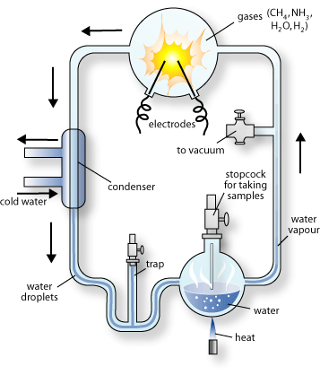
The First Organic Molecules
Miller and Urey tested a theory that organic molecules could form under early Earth conditions.

Slide 4
Theories for the Origin of Life
Abiogenesis (Spontaneous Generation)
Scientists believed that life could be produced from nonliving matter.
Ex: rotting meat → maggots

Slide 5
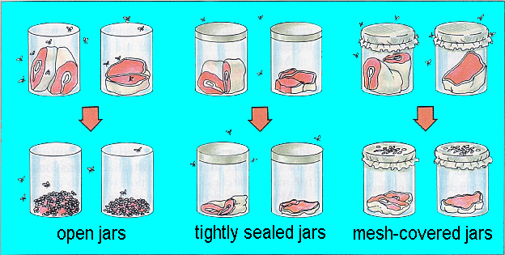
Theories for the Origin of Life
Francisco Redi (1668) designed a controlled experiment to disprove spontaneous generation.
Scientists thought that this only proved that large organisms (not microorganisms) had to come from other organisms.

Slide 6
Theories for the Origin of Life
Louis Pasteur (mid 1800s) designed a controlled experiment to show that micro-organisms cannot spontaneously arise.

Slide 7
Theories for the Origin of Life
Scientists now acknowledge biogenesis, living organisms come only from other living organisms.

Slide 8
The Evolution of Cells
The first cells were probably heterotrophic, anaerobic, prokaryotes.
Why??

Slide 9
The Evolution of Cells
Next to come along were chemosynthetic bacteria
Photosynthesizing bacteria evolved next, producing oxygen.
After oxygen built up in the atmosphere. Aerobic bacteria evolved.

Slide 10
The Evolution of Cells
Oxygen in the atmosphere was converted to ozone by lightening giving Earth the ozone layer.
The ozone layer protects from solar radiation.
This allowed more complex organisms to evolve.

Slide 11
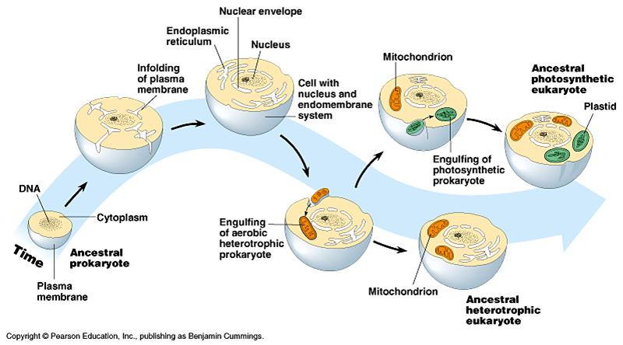
The Evolution of Cells
Endosymbiotic Theory: Eukaryotic cells may have evolved from bacteria living inside other bacteria

