Slide 1
BASIC CHEMISTRY

Slide 2
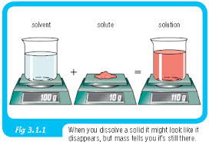
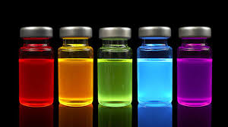
Solutions
Solution – a mixture in which substances are evenly distributed
Examples: sweet tea, Kool Aid, hot chocolate
Solute – substance that gets dissolved
Examples – sugar, salt
Solvent – agent that dissolves others
Example - Water is called the universal solvent

Slide 3
Concentrations
High concentration: lot of solute. Thick, can be diluted by adding solvent.
Example: sweet tea
Low concentration– lots of solvent. Thin and runny, can be thickened by adding solute.
Example: unsweetened tea
Concentration gradient – difference in concentration

Slide 4
Acids & Bases
The pH scale measures the H+ or OH- released when something is placed in water.
It ranges from 0 to 14. Acids are 0 up to 7. A pH of 7 is neutral. Anything above 7 up to 14 is a base.

Slide 5
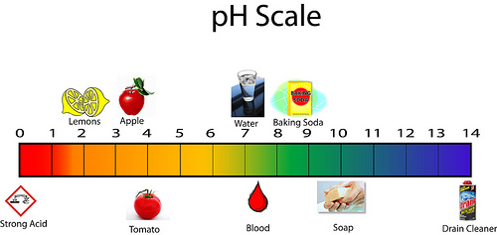
Acids & Bases
Strong acids and bases are towards the ends. Weak acids and bases are closer to 7.
Below are some examples of things of varying pH levels.

Slide 6
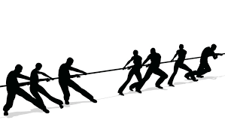
BUFFERS
Buffers are substances that can act as weak acids or weak bases to balance pH and maintain homeostasis.
Neutralization occurs when a substance of equal strength cancels out the strength of the solution.

Slide 7
Macromolecules AKA Organic Molecules AKA Biochemistry

Slide 8
Monomer – small organic subunit
It’s basically a building block.

Slide 9
Polymer– large molecules containing many monomers.
It’s what you make out of the building blocks!

Slide 10
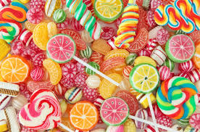
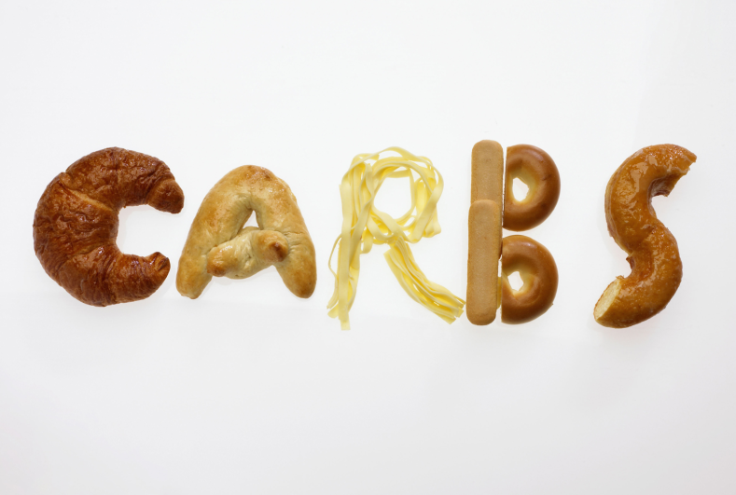
Carbohydrates
The function of a carbohydrate is to provide short-term energy.
Carbs are either sugars (monosaccharides) or starches (polysaccharides).
The monomers, or building blocks, of carbs are monosaccharides (simple sugars).
Polysaccharides are called complex carbs.

Slide 11
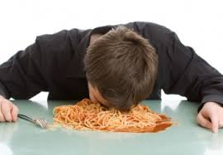
Carbohydrates
Monosaccharides give us a quick energy rush.
Think a kid eating candy.
Polysaccharides give us slightly longer energy.
Think athletes carb-loading on pasta.

Slide 12
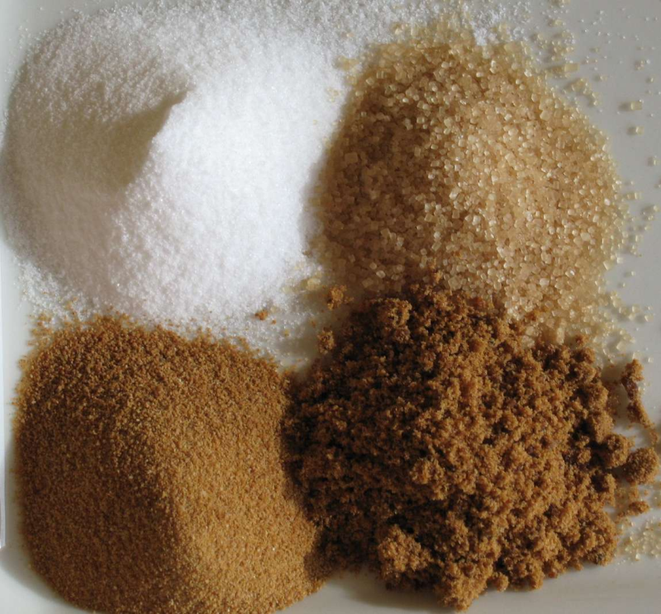
Carbohydrates
Sugars often end in –ose.
Examples: glucose, fructose, lactose
Polysaccharides are made of many monomers
Starch
Glycogen
Cellulose
Chitin

Slide 13
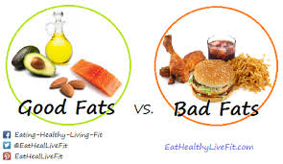
Lipids
Lipids provide long-term energy.
Examples are fats, oils, and waxes.
Steroids are also lipids.
The monomer of a lipid is 3 fatty acids and a glycerol.
Lipids are insoluble in water. This is because they are non-polar.
The brown paper bag test is used to identify a lipid.

Slide 14
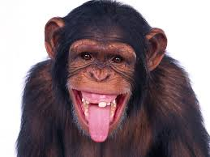
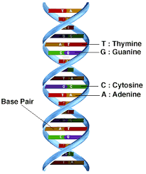
Nucleic Acids
They store and transmit genetic information.
They make us what we are.
Over 99.9% of our DNA is the same.
African chimpanzees share 98% of
our DNA.
This tells us that a little change in
our DNA can make a BIG difference.

Slide 15
Nucleic Acids
Their monomer is a nucleotide.
Nucleotides are made of a sugar, a phosphate, and a nitrogenous base.
All living things contain nucleic acids.
DNA has complementary bases (A=T & C=G).

Slide 16
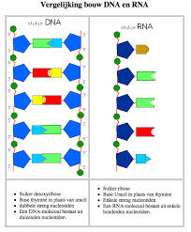
Nucleic Acids – DNA & RNA
DNA and RNA are examples.
DNA has the sugar deoxyribose.
RNA has the sugar ribose.
DNA has the bases A,T, G, & C.
RNA has the bases A, U, G, & C.
DNA is in the structure of a
double helix.
RNA is single-stranded.

Slide 17
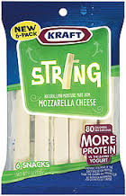
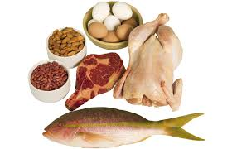
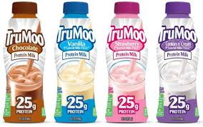
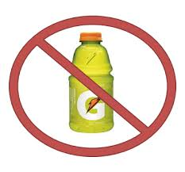
Proteins (Polypeptide)
Function – various biological functions
makes up hair and fingernails
helps fight disease in immune system
speeds up chemical reactions
builds muscle and aids in recovery
makes hormones
Amino acids are monomers of protein.
Protein is found in meat, cheese, beans, nuts, soy, and milk.

Slide 18
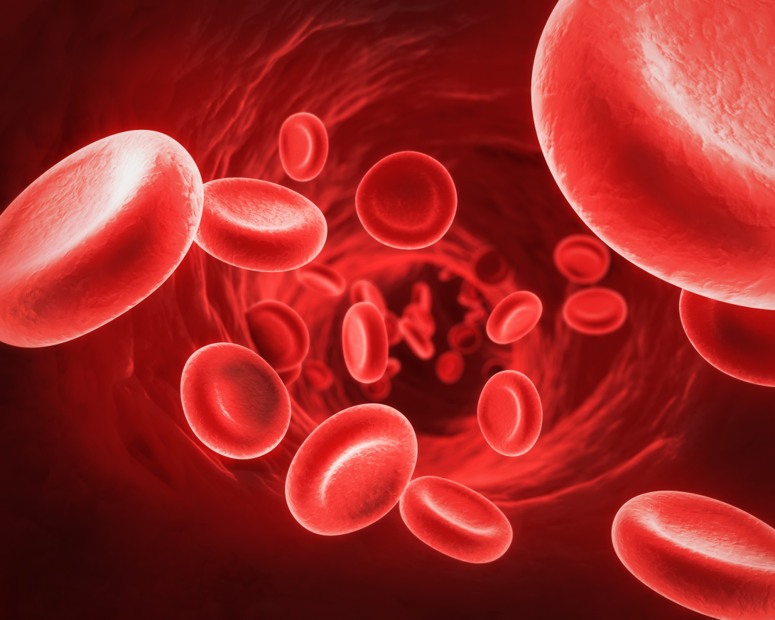
Proteins
Hemoglobin is a protein that carries oxygen in our RBC’s.

Slide 19
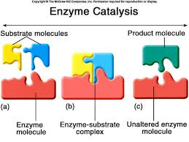
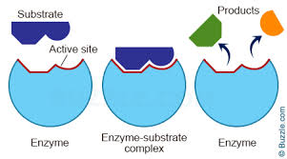
Proteins - Enzymes
Enzymes are an important type of protein.
Enzymes are biological catalysts.
Catalysts are things that speed up chemical reactions.
Lighter fluid is a catalyst.
Enzymes work by lowering the activation energy(energy needed to start a reaction).

Slide 20
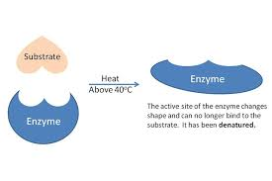
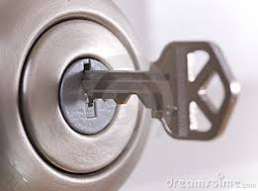
Proteins - Enzymes
Enzymes fit together with substrates. They are said to fit together like a LOCK and KEY.
Enzymes that have been denatured (misshaped) do not work.
Think lactose-intolerance (lactase).
Temperature and pH
can denature
enzymes.

