Slide 1
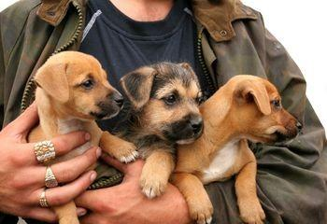
MEIOSIS
Chapter 11-4

Slide 2
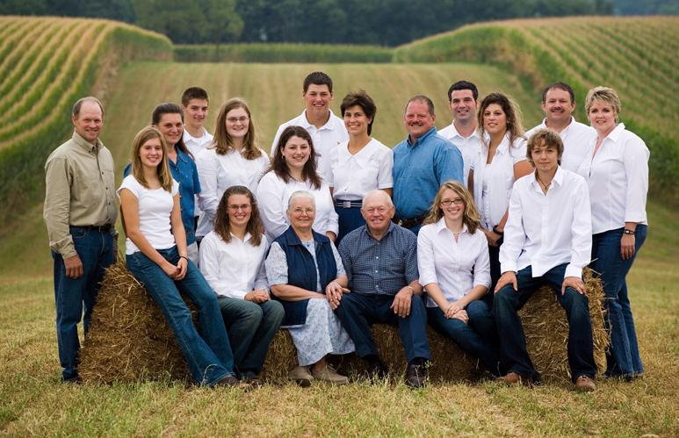
Parents can produce many types of offspring
Families will have resemblances, but no two are exactly alike

Slide 3
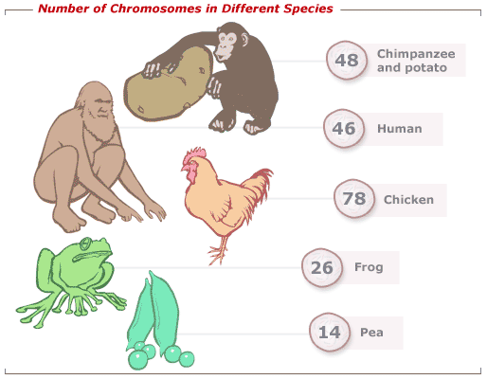
Every cell has a nucleus
Every nucleus has chromosomes
The number of chromosomes depends on the species
Ex. Humans have 46

Slide 4
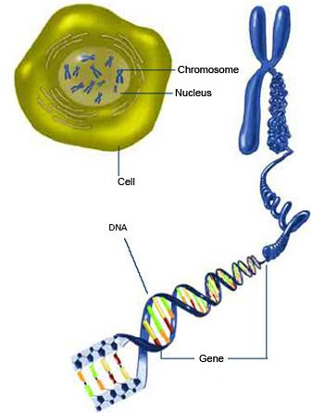
GENES are located on chromosomes
genes control the TRAITS of the individual
genotype determines phenotype

Slide 5
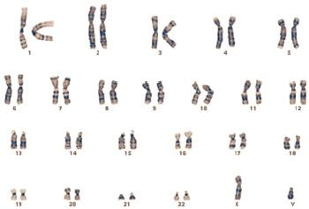
Chromosomes come in matching sets
-these are called homologous pairs (one from mom (maternal) and one from dad (paternal)

Slide 6
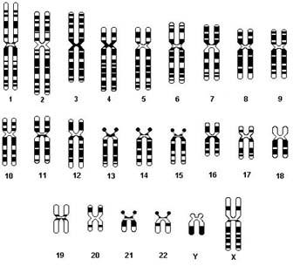
FIND THE HOMOLOG!

Slide 7
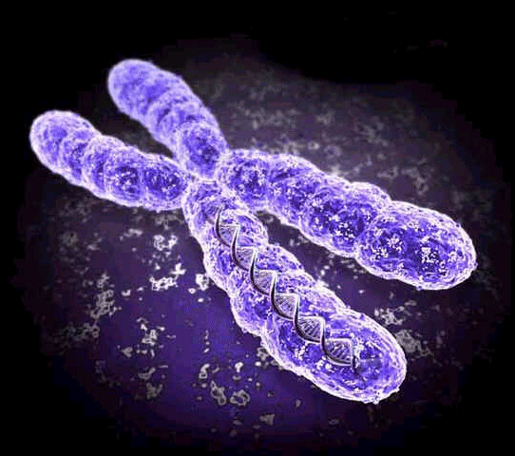
Cells in your body have a complete set (all 46) - they are called DIPLOID (2n)
Sex cells (sperm and eggs) only have half (23) - they are called HAPLOID (n)

Slide 8
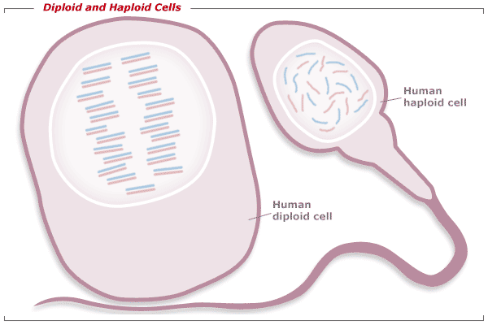

Slide 9
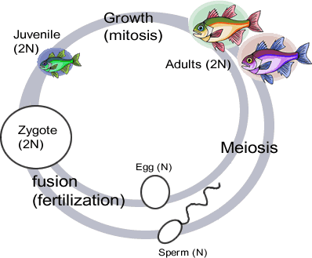
When GAMETES combine, the ZYGOTE (offspring) gets half from mom (23) and half from dad (23)
ZYGOTES are diploid (46)

Slide 10
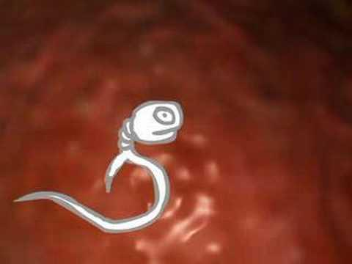
When sperm and egg meet, their chromosomes much match for the zygote to develop properly.

Slide 11
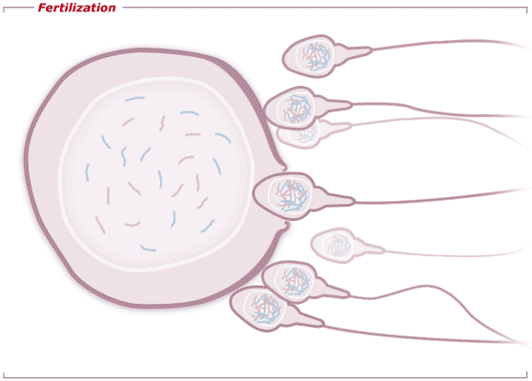
Let's review terms......
1. Matching sets of chromosomes are called ________ pairs
2. Egg and sperm combine to make a _______________
3. Egg and sperm are both known as _______________
4. A cell that only has half of a set of chromosomes is said to be _______________.
5. Genes are located on ___________________

Slide 12
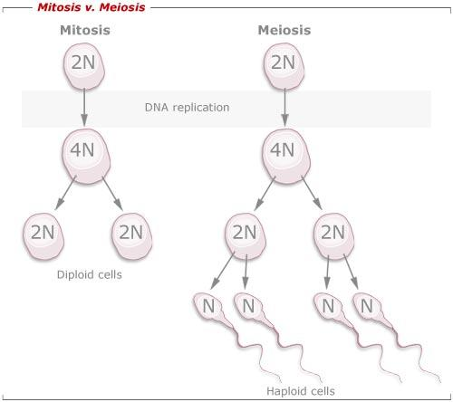
The process of creating a gamete (sex cell) is called MEIOSIS
It is similar to mitosis, but will produce 4 daughter cells that are each unique and haploid.

Slide 13
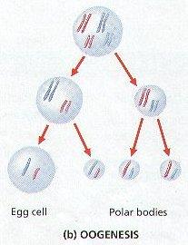
OOGENESIS - makes eggs (ovum)

Slide 14
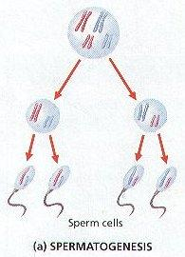
Spermatogenesis - makes sperm

Slide 15
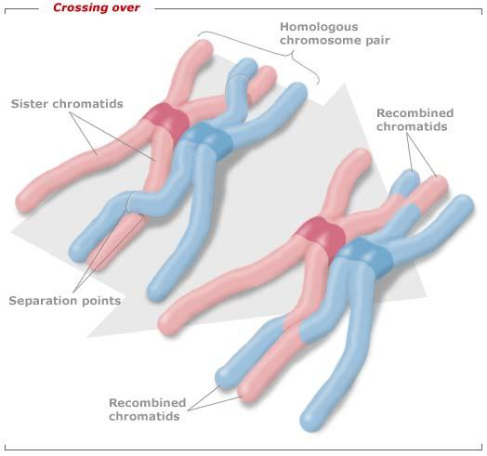
PROPHASE I of MEIOSIS
- homologous pairs form
-chromosomes trade genes,
CROSSING -OVER

Slide 16
PROPHASE I
Homologous chromosomes
sister chromatids
sister chromatids
Tetrad

Slide 17
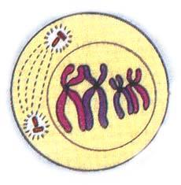
Crossing-over increases the number of possible gene combinations

Slide 18
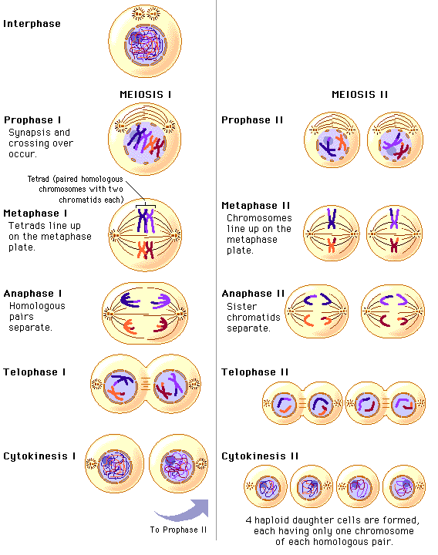
Steps of Meiosis

