Slide 1
Domain Bacteria
Contains only one kingdom – Eubacteria
Cell type: Prokaryote
Cell structures: Cells with peptidoglycan
# of cells: Unicellular
Nutrition: Autotroph or heterotroph
Examples: Streptococcus, Escherichia coli
These are your ORDINARY, every-day bacteria.

Slide 2
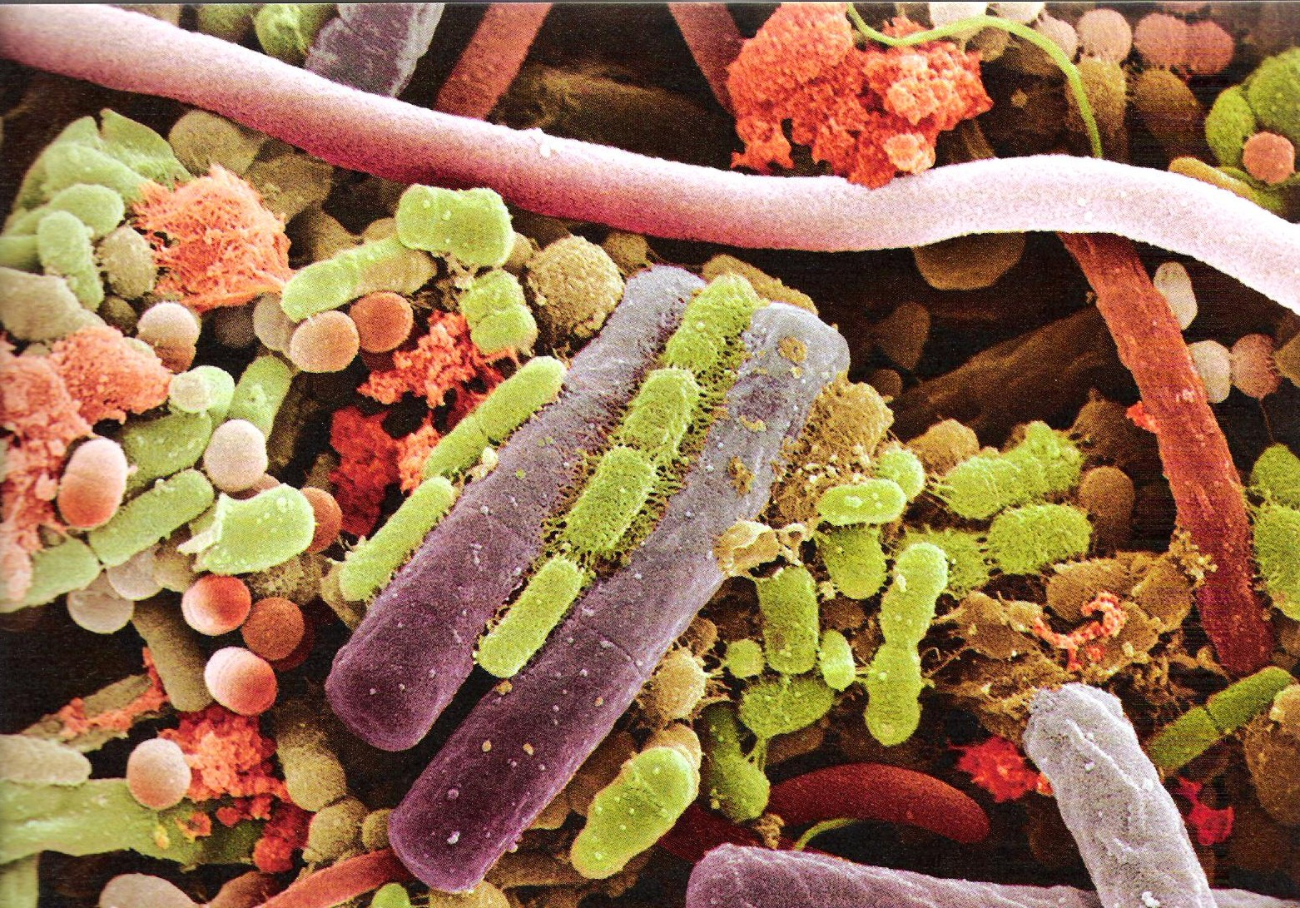

Slide 3
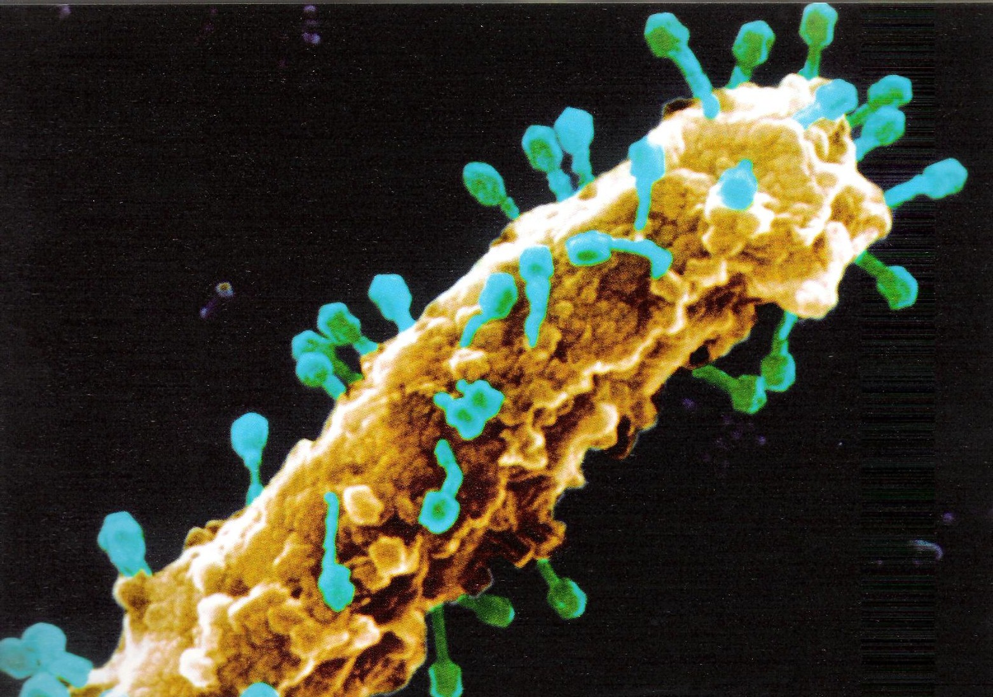
E. coli This bacterium (brown) is being attacked by dozens of
bacteriophages (viruses that attack bacteria)

Slide 4
Domain Archaea
Contains only one kingdom – Archaebacteria
Cell type: Prokaryote
Cell structure: Cell walls without peptidoglycan
# of cells: Unicellular
Nutrition: Autotroph or heterotroph
Examples: Methanogens, halophiles, thermophiles
These are your EXTREME ENVIRONMENT organisms. Although they are unicellular, they are probably more closely related to humans than they are to Eubacteria.

Slide 5
Domain Eukarya
Contains 4 kingdoms
1) Protista
2) Fungi
3) Plantae
4) Animalia

Slide 6
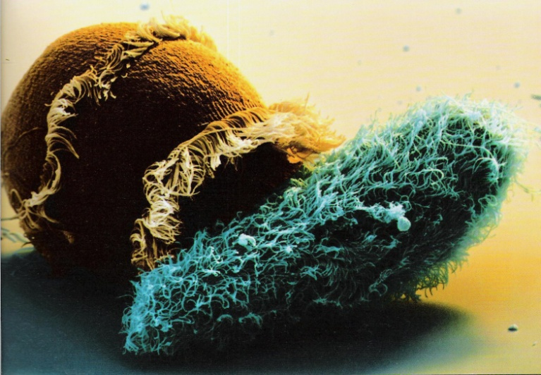
Kingdom: Protista
Cell type: Eukaryote
Cell structures: Cell walls of cellulose in some (but not all), some have chloroplasts
# of cells: Most unicellular; some colonial; some multicellular
Nutrition: Autotroph or heterotroph
Examples: Amoeba, Paramecium, slime molds, giant kelp, algae

Slide 7
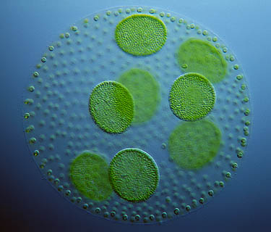
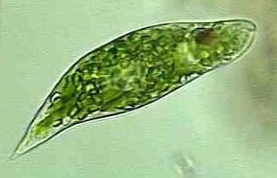

Slide 8
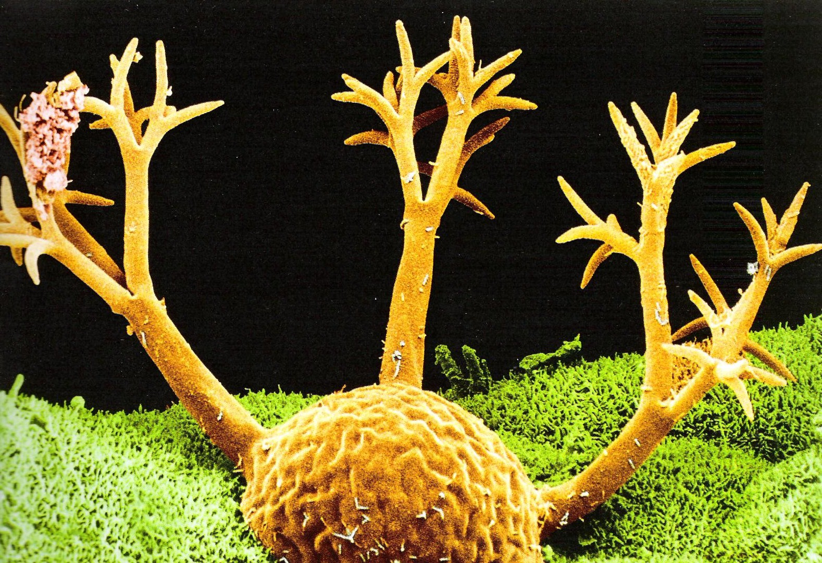
Protozoan

Slide 9
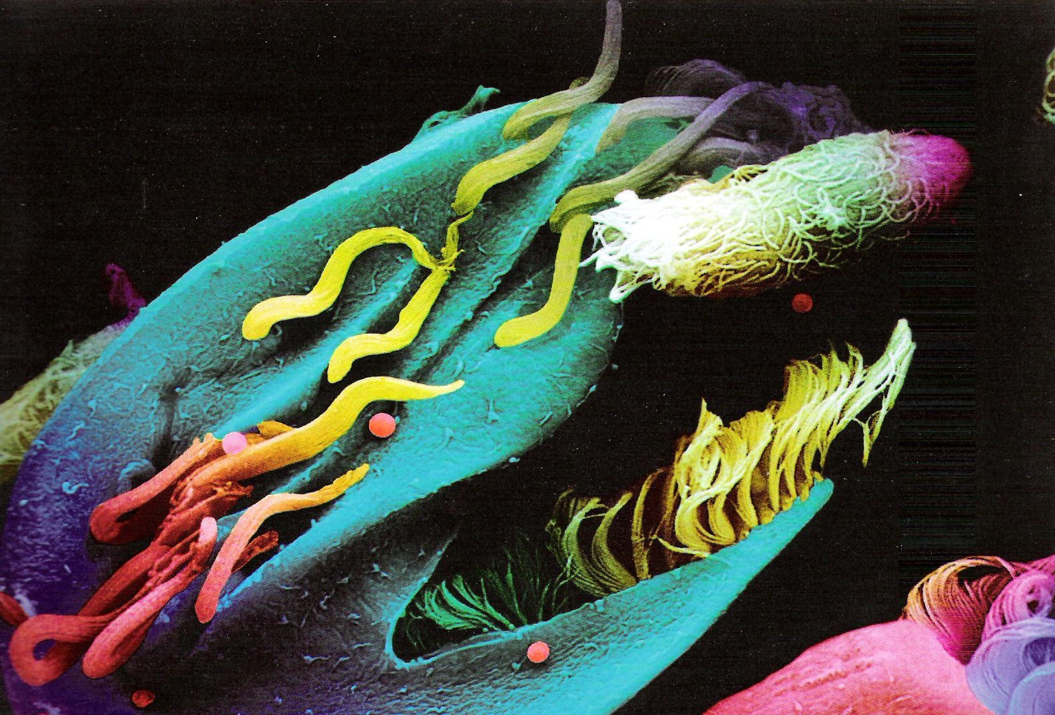
Bundles of cilia
Two protozoans…
This one is about to be eaten!

Slide 10
Kingdom: Fungi
Cell type: Eukaryote
Cell structures: Cell walls of chitin
# of cells: Most multicellular; some unicellular
Nutrition: Heterotroph
Examples: Mushrooms, yeast, mold

Slide 11
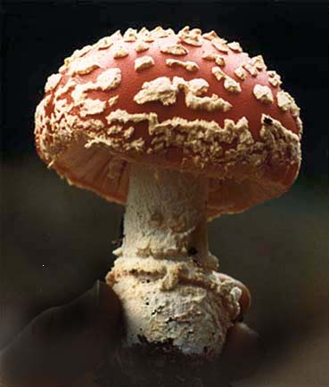
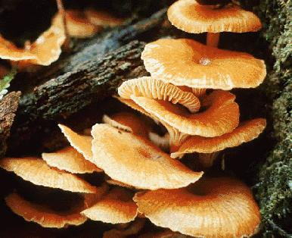

Slide 12
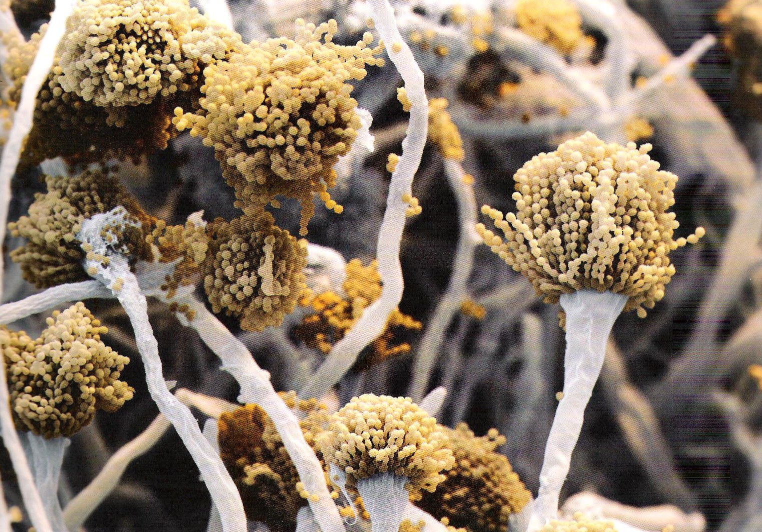
Extreme close-up of the underside of a mushroom, showing the reproductive
spores (brown dots).

Slide 13
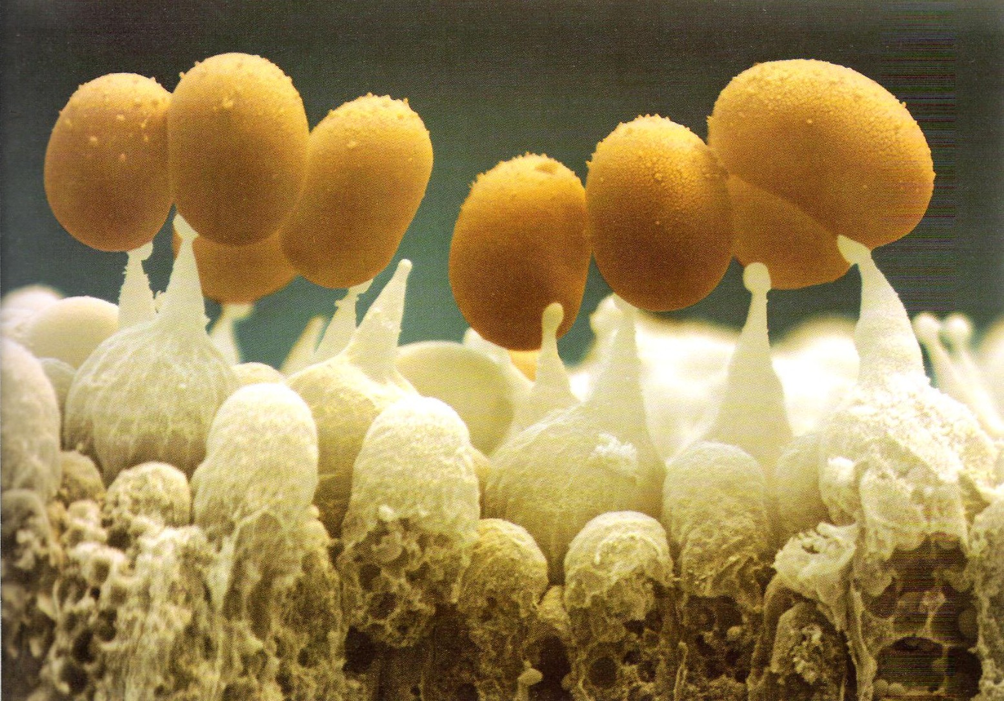
ExtrEEEEEEEEme closeup of mushroom spores!

