Slide 1
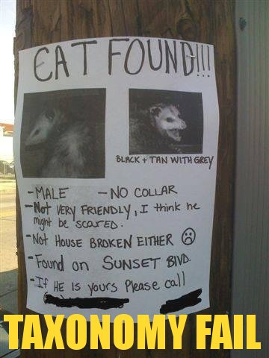
Taxonomy/Classification

Slide 2
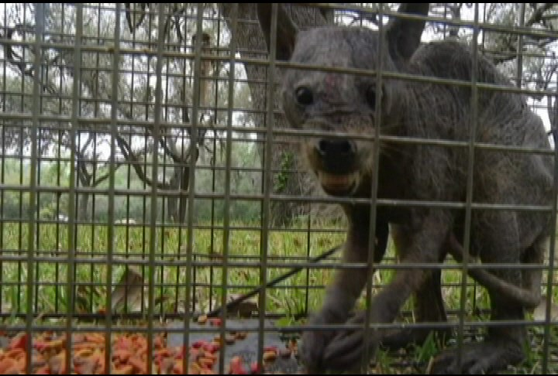
Taxonomy
The study of classifying organisms
What is it?!!

Slide 3
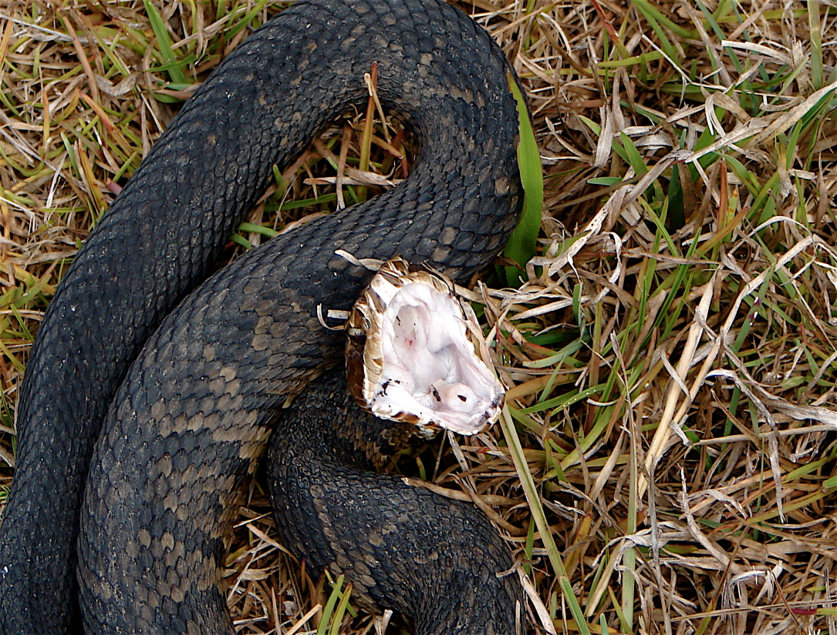
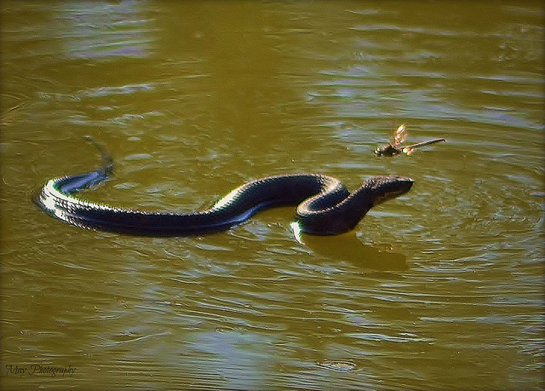
Why study taxonomy?
Which is more dangerous?
The cottonmouth snake OR The water moccasin

Slide 4
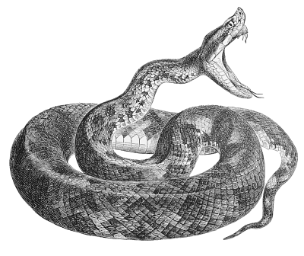
They are one and the same.
Taxonomy doesn’t have this problem because it is simply known as Agkistrodon piscivorus

Slide 5
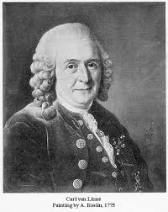
Carolus (Carl) Linneaus AKA The Father of Taxonomy
Swedish botanist who developed the two word naming system known as binomial nomenclature.
He developed groups or taxa to distinguish organisms based on their characteristics.

Slide 6
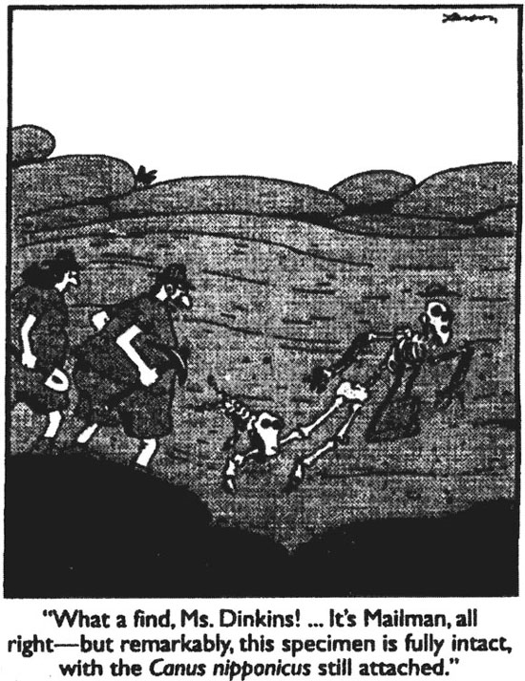
CLASSIFICATION
Domain
D
K
P
Kingdom
F
O
Class
C
Phylum
G
S
Order
Family
Genus
Species

Slide 7
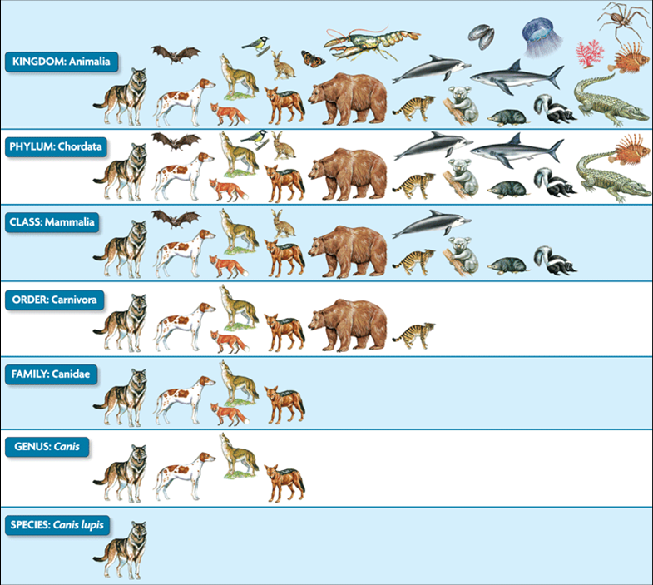
For example:
the gray wolf
or timber wolf

Slide 8
Binomial Nomenclature
Classifying organisms according to binomial nomenclature must follow a few rules:
The name must be in Latin
The Genus and the Species are used as the name
The Genus is capitalized and species is not
It must be italicized
Eg. Homo sapien, Canis familiaris

Slide 9
OLD, FIVE KINGDOM CLASSIFICATION
Moneran
Bacteria
Prokaryotic
Protist
Protozoans, algae
Eukaryotic
Fungi
Mushroom, yeast
Plant
No nucleus
Unicellular
Can be heterotrophic or autotrophic
Animal
Mainly unicellular
Can be heterotrophic or autotrophic
Have nucleus
Have cell wall
Some have cell wall
Eukaryotic
Have nucleus
Have cell wall
Mainly multicellular
heterotrophic
Moss, fern, trees, flowers
Eukaryotic
Have nucleus
Have cell wall
All multicellular
autotrophic
Sponge, annelids, amphibians, birds, mammals
Eukaryotic
Have nucleus
No cell wall
All multicellular
heterotrophic

Slide 10
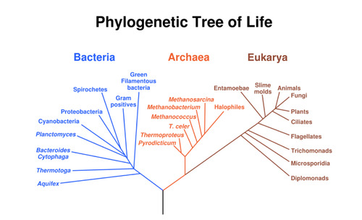
Today’s Three Domain System

Slide 11
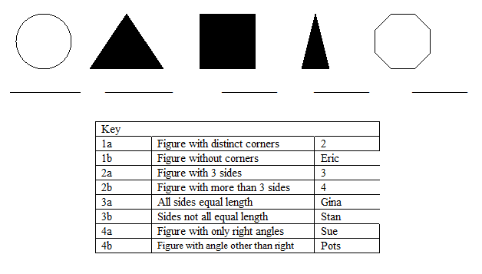
Dichotomous key
Always begin with #1
Follow directions using choices given
Stop when you get to the correct name
(Remember to compare and contrast figures)

