Slide 1
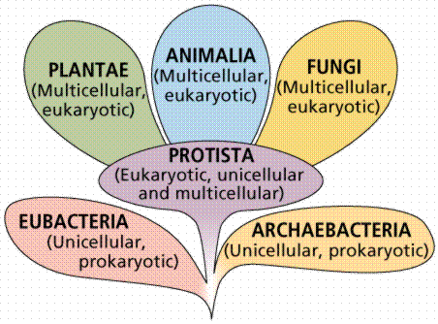
THE 6 MODERN KINGDOMS

Slide 2
EUBACTERIA
MEANS “TRUE” BACTERIA
COMMON, EVERYDAY BACTERIA
DECOMPOSERS
CAN CAUSE DISEASE

Slide 3
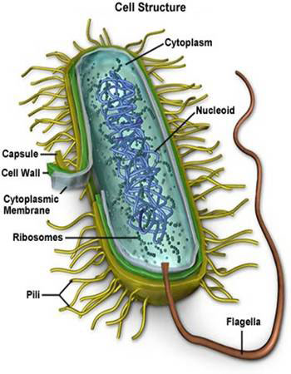
What is a Bacterium?
Lacks a nucleus
Has a cell wall used for support and protection
Have cilia or flagella

Slide 4
BACTERIA vs VIRUSES
Bacteria
Virus
Made of cells
Can be killed by antibiotics
Examples of disease caused by bacteria is strep throat
Not made of cells
MUCH SMALLER THAN CELLS
Can’t be killed by antibiotics
Example of diseases caused by viruses are AIDS (HIV), Smallpox, Influenza

Slide 5
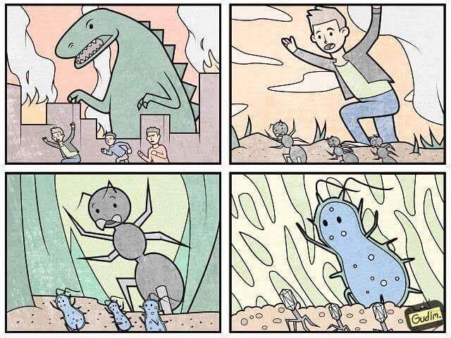
Virus VS. Bacteria – Which is smaller?

Slide 6
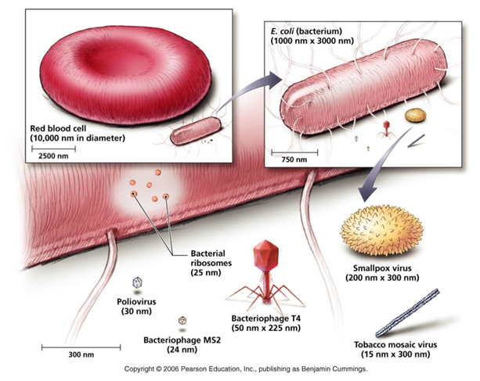
BACTERIA vs VIRUSES

Slide 7
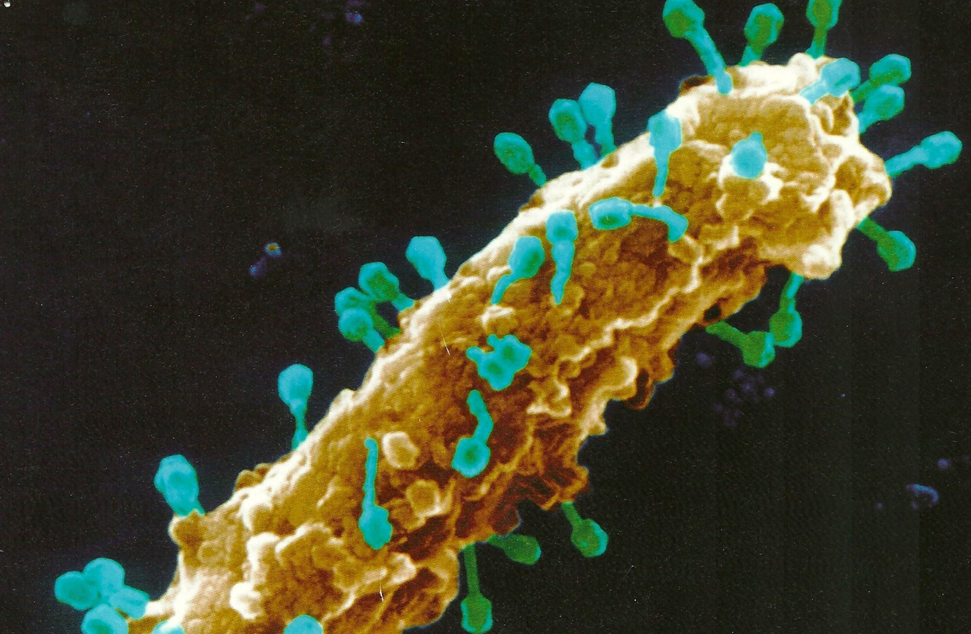
Bacteria being attacked by viruses

Slide 8
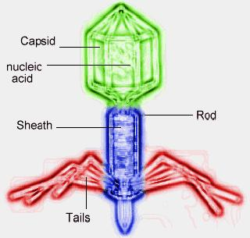
VIRUSES
VIRUS STRUCTURE
Viral reproduction
A virus is not made of cells
It is nucleic acid (DNA or RNA) surrounded by protein coat (capsid)
Virus can’t reproduce unless it is inside a living cell
The virus uses the cells enzymes and ribosomes to make DNA and protein
New viruses either bud off of the cell or the cell bursts, releasing lots of viruses

Slide 9
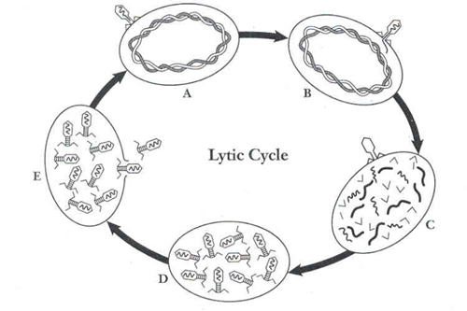
HOW VIRUSES REPRODUCE

Slide 10
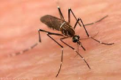
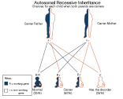
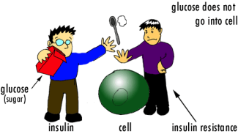
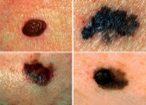
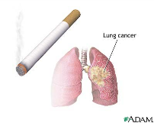
Internal and external factors in disease
Malaria
Mosquitoes transmit malaria
PKU
Individuals who have PKU can’t break down phenylalanine
If it builds up it can cause mental retardation
Keep individuals with
PKU on a diet, they don’t have brain damage
Lung Cancer
Lung cancer is uncontrolled growth of cells in the lungs
Diabetes
Light skinned people don’t have the natural melanin protection of darker skinned people
Skin Cancer
Individuals who have the sickle cell trait (heterozygous) aren’t as affected as homozygous individuals
Individuals who smoke are more likely to get lung cancer
Diabetes results from when the pancreas fails to make enough insulin
Individuals who are overweight and who don’t exercise seem to be more affected
Overexposure to sunlight can trigger the changes that lead to skin cancer

Slide 11
IMMUNITY & WHITE BLOOD CELLS
B-cells
White blood cell
Make antibodies
T- helper cells
White blood cell
T-killer cells
White blood cell
Kill virus infected cell
Help coordinate immune response

Slide 12
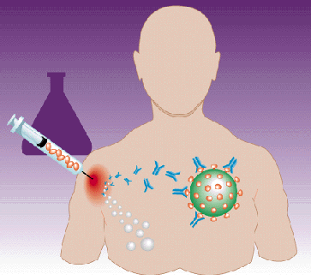
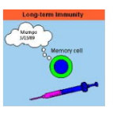
PASSIVE vs. ACTIVE IMMUNITY
Passive Immunity
Active Immunity
Person does NOT make memory cells or antibodies
Antibodies only are transferred
Doesn’t provide long-term protection
Natural: from breastfeeding
Artificial: Rabies “shot”
Person DOES make antibodies AND memory cells
Provides long term immunity
Natural: you have disease
Artificial – you get a VACCINATION

Slide 13
ARCHAEBACTERIA
LIVE IN EXTREME ENVIRONMENTS

Slide 14
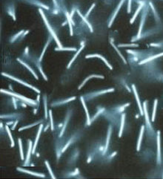
Archaebacteria
Methanogens:
Do not need O₂ (anaerobic)
Live in thick mud and digestive tracts of animals.

Slide 15
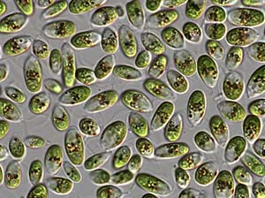
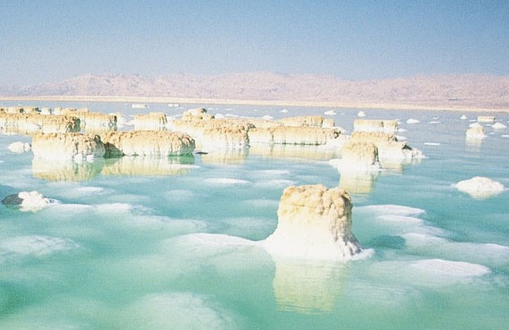
Archaebacteria
Halophiles:
Live only in environments with lots of salt.
Ex. Great Salt Lake, Dead Sea

Slide 16
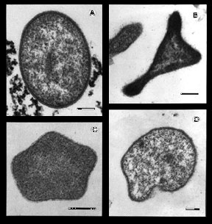
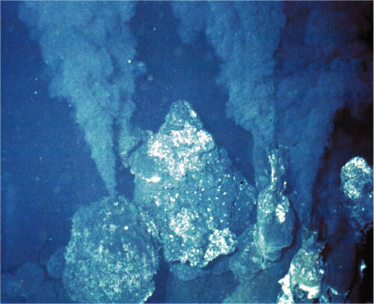
Archaebacteria
Thermophiles:
Live in hot, boiling water.
Ex. Hot springs, deep sea vents

